Slide 1
DEPARTMENT OF MUSIC BHARATI COLLEGE UNIVERSITY OF DELHI
ANNUAL REPORT 2024-2025
UNDER THE GUIDANCE OF
DR. AMIT SINGH, TIC (2024-25)
DR. SARITA PATHAK YAJURVEDI

Slide 2
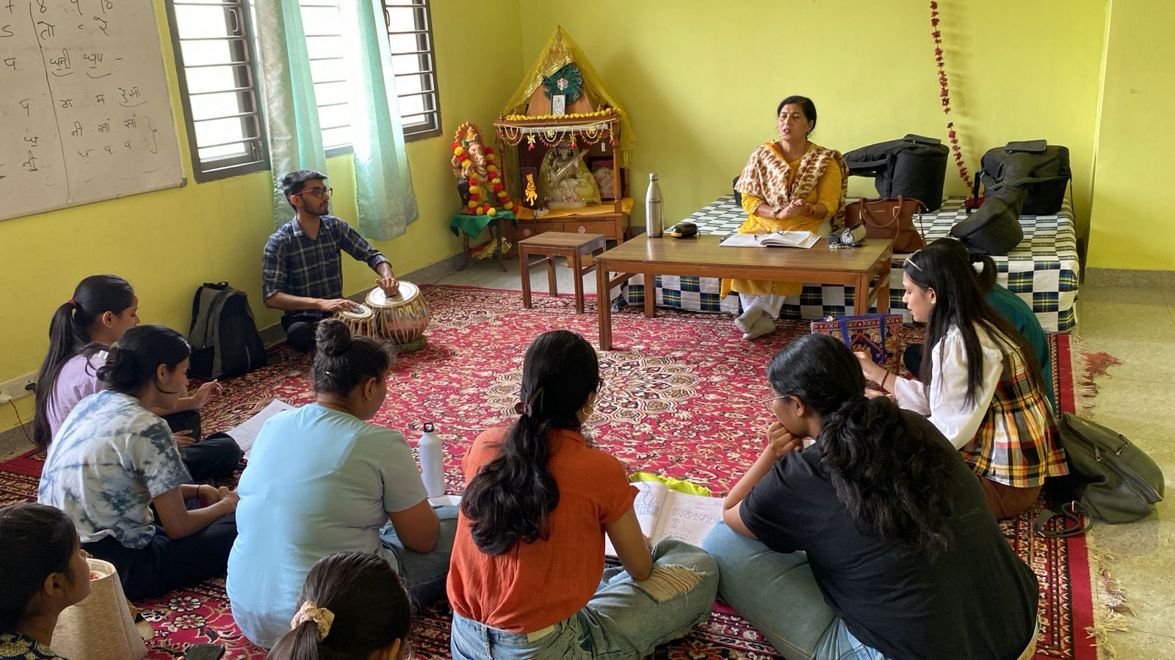
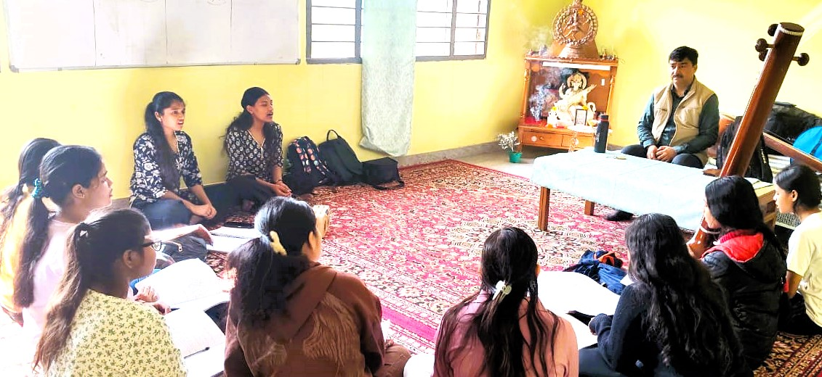
CLASS REPRESENTATION

Slide 3
CLASS REPRESENTATION
The music classes at Bharati College are held in the music room of the auditorium building. These classes are designed to help students learn both in groups and individually. The Department of Music believes in giving students a complete learning experience that includes vocal training, use of musical instruments, and a deeper understanding of Indian classical music.
During regular class sessions, students sit together and practice their vocals. They are often accompanied by Indian classical instruments such as the Tanpura, Tabla, and Harmonium. These instruments help students learn the correct pitch, rhythm, and coordination. The professors guide the students throughout the class, helping them improve their techniques, fix their mistakes, and motivate them to do better. The learning environment is peaceful and focused, allowing students to enjoy and absorb the music fully.
Along with group practice, solo practice is also a key part of the classes. Each student is given time and space to practice on their own using the instruments. Solo practice allows students to concentrate better, understand their strengths and weaknesses, and develop their musical skills in a personal way. This helps students grow more confident and perform better in both internal and external evaluations.

Slide 4
CLASS REPRESENTATION
Students from different courses take part in these classes. Whether they are pursuing a Major in Music, Minor in Music, or have chosen Music as a Generic Elective (GE), each student is given equal attention and support. The department ensures that every student, regardless of their course, gets the chance to learn and express themselves through music.
These music classes not only improve the students’ musical talent but also build discipline, patience, and creativity. The teaching approach of the department is thoughtful and student-friendly. Professors Dr Amit Singh and Dr Sarita Pathak Yajurvedi lead the classes with great dedication and care. They bring years of knowledge and experience, and they constantly work to help students become better musicians.
Overall, the music classes at Bharati College provide a unique and rich experience. With a mix of group learning, solo practice, and expert guidance, the Department of Music plays an important role in shaping the musical journey of its students.

Slide 5
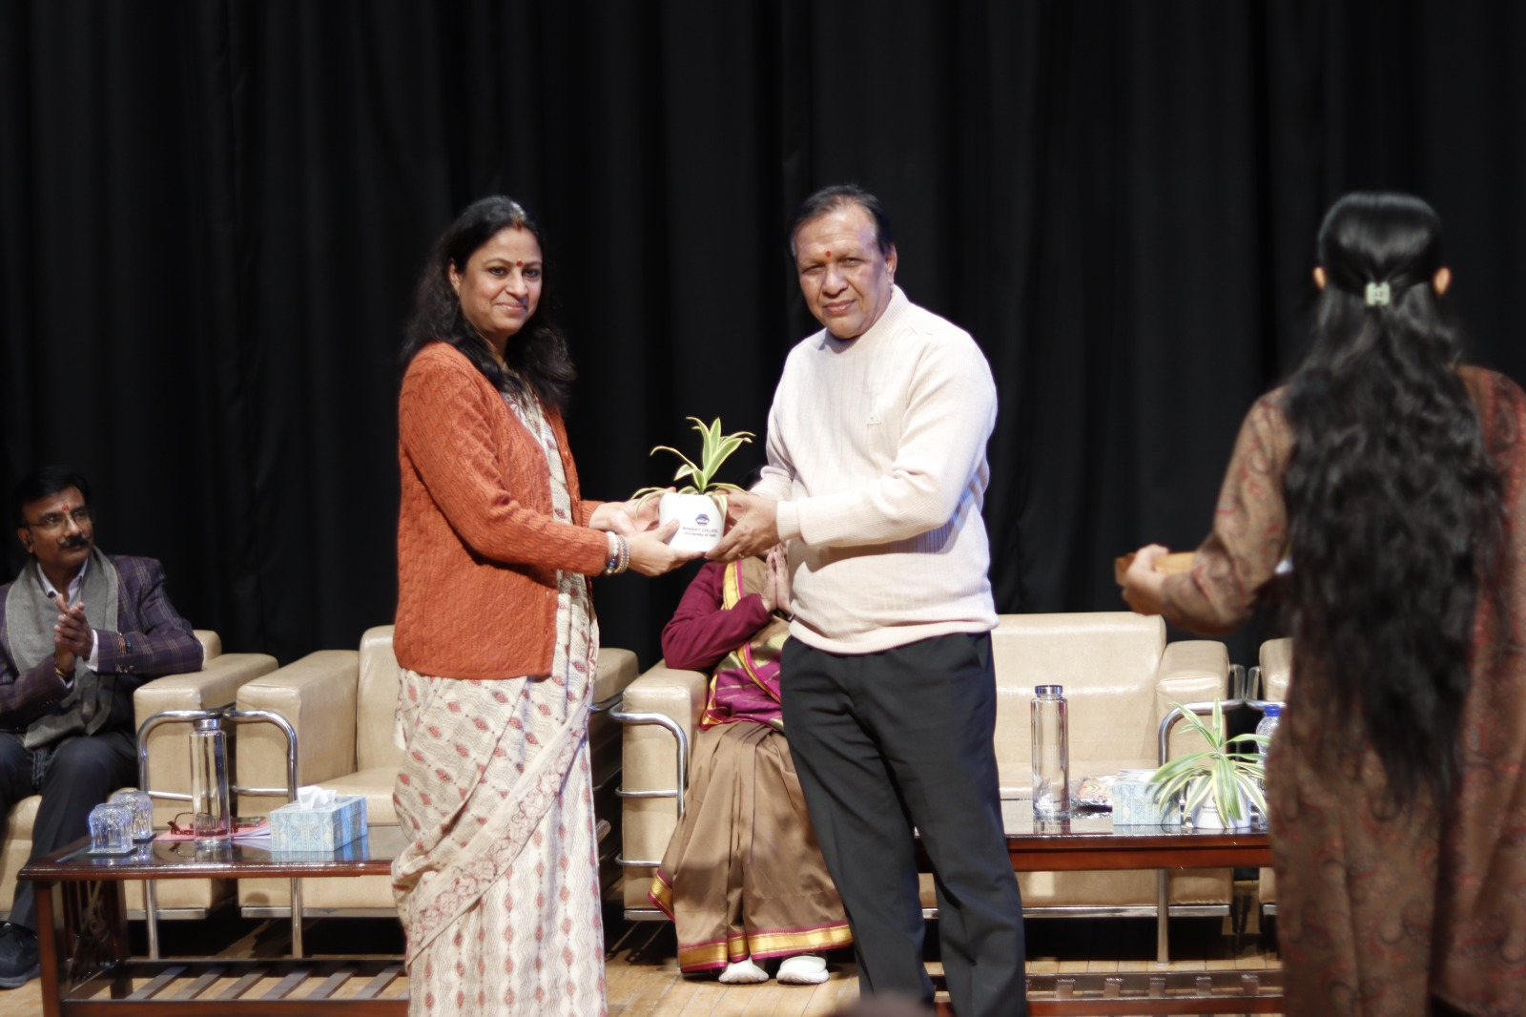
हमारी संस्कृति हमारी परंपरा 14 दिसंबर 2024: संगीत विभाग एवं आईएमसीटीएफ के संयुक्त तत्वाधान में आयोजित

Slide 6
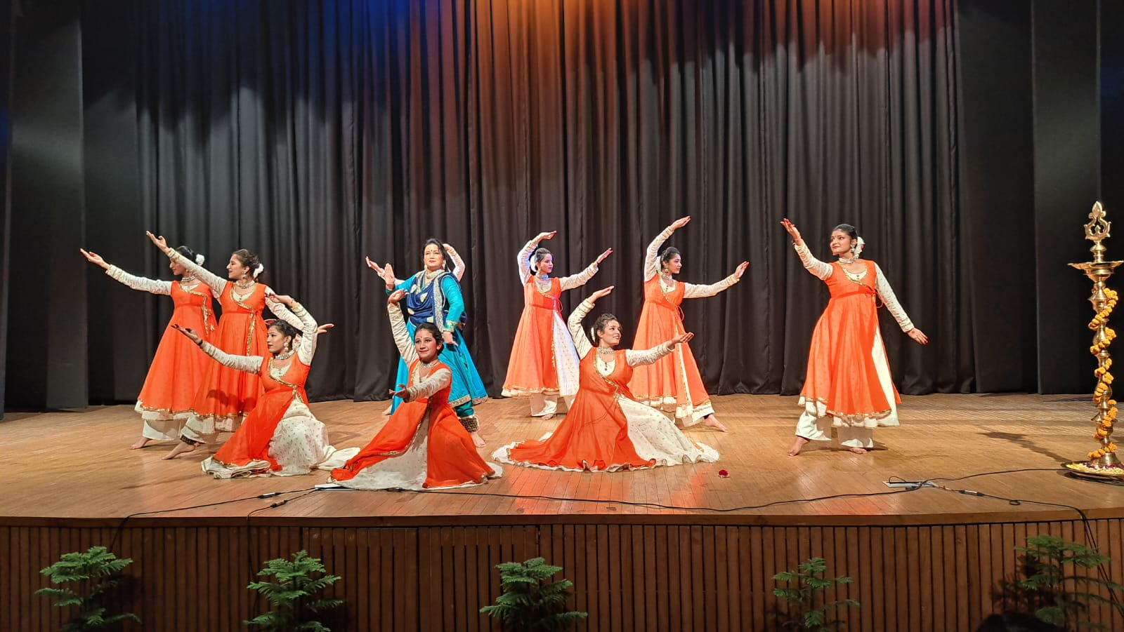
हमारी संस्कृति हमारी परंपरा 14 दिसंबर 2024: संगीत विभाग एवं आईएमसीटीएफ के संयुक्त तत्वाधान में आयोजित

Slide 7
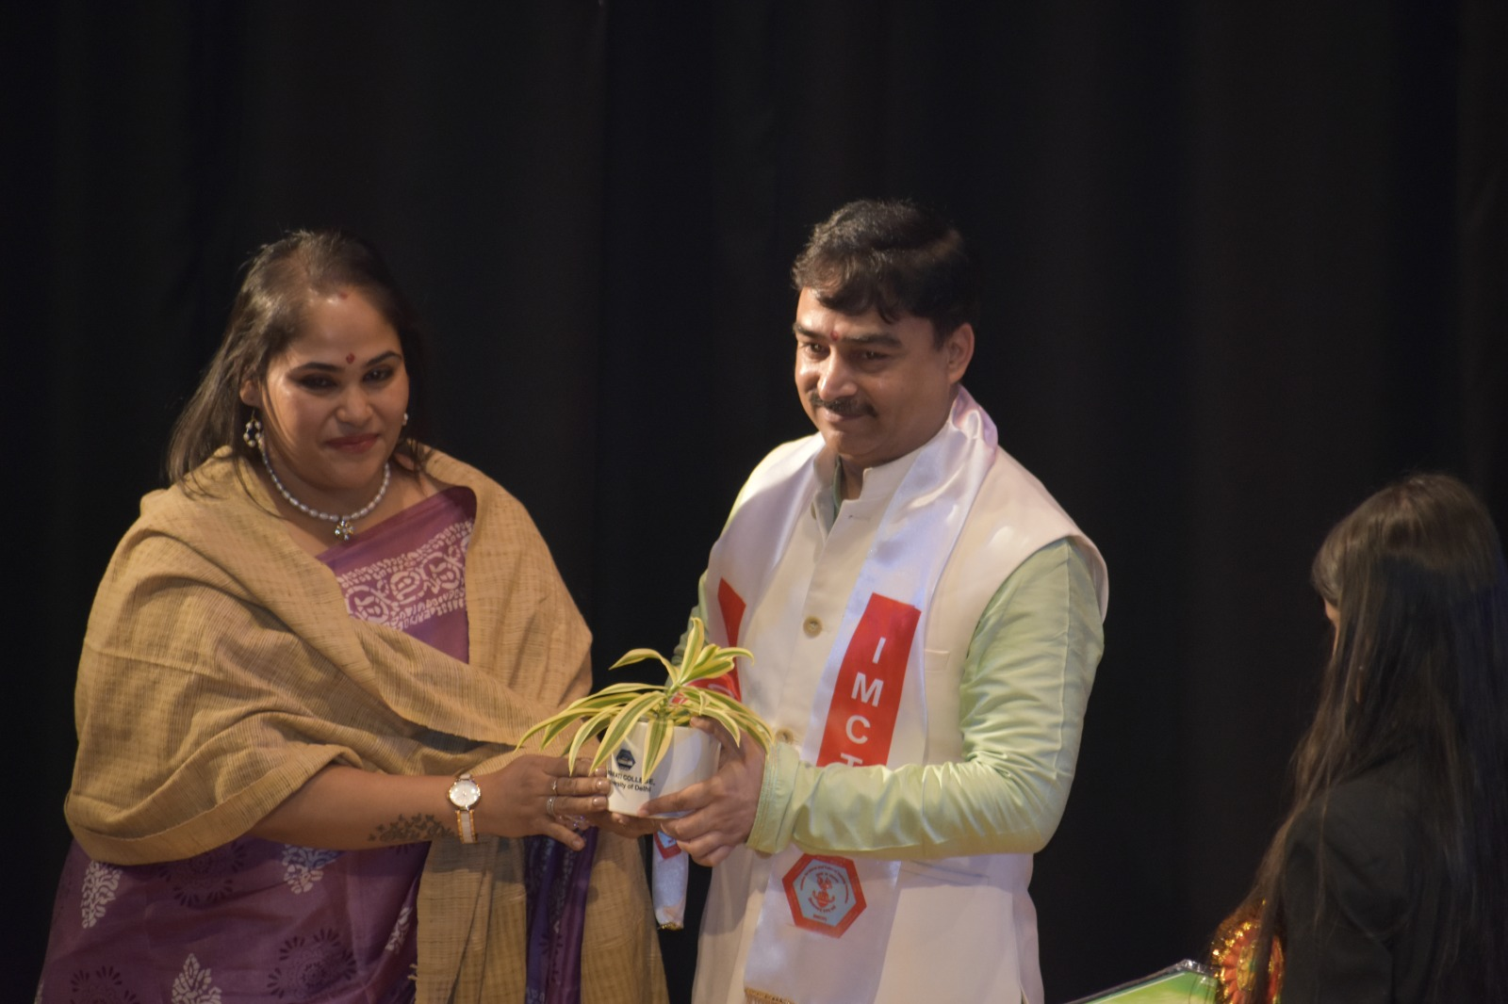
हमारी संस्कृति हमारी परंपरा 14 दिसंबर 2024: संगीत विभाग एवं आईएमसीटीएफ के संयुक्त तत्वाधान में आयोजित

Slide 8
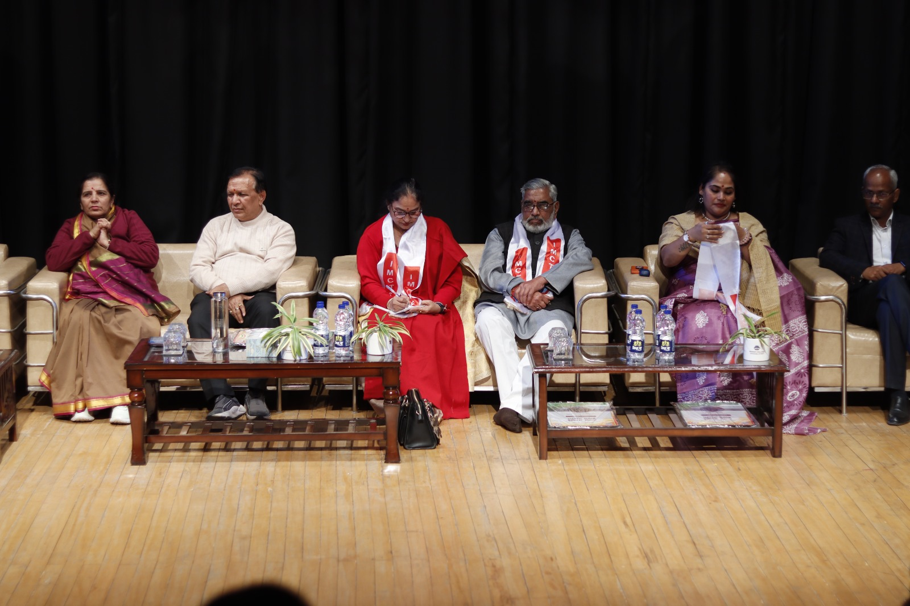
हमारी संस्कृति हमारी परंपरा 14 दिसंबर 2024: संगीत विभाग एवं आईएमसीटीएफ के संयुक्त तत्वाधान में आयोजित

Slide 9
हमारी संस्कृति हमारी परंपरा 14 दिसंबर 2024: संगीत विभाग एवं आईएमसीटीएफ के संयुक्त तत्वाधान में आयोजित
कार्यक्रम का विधिवत उद्घाटन मुख्य अतिथि श्री लक्ष्मी नारायण भाला ने दीप प्रज्वलित करके किया एवं भारतीय कॉलेज के संगीत विभाग की छात्राओं ने सुमधुर कंठ में मां सरस्वती की वंदना प्रस्तुत की, सर्वप्रथम प्राचार्य प्रोफेसर सलोनी गुप्ता ने कार्यक्रम की भूमिका एवं महत्व से सभी को अवगत कराया कि यह कार्यक्रम छात्र-छात्राओं बच्चों एवं युवाओं में भारतीय संस्कृति एवं परंपराओं एवं पारिवारिक मूल्यों को गहराई से समझने एवं जन जागृति के उद्देश्य से किया गया । कार्यक्रम का मुख्य आकर्षण शंकरदेव के जीवन को जीवंत करती हुई नृत्य नाटिका "शंकर देव चरित" रहा। नृत्यनाटिका का लेखन वरिष्ठ साहित्यकार एवं लेखक श्री लक्ष्मी नारायण भाला ने किया है। संगीत रचना प्रसिद्ध संगीतज्ञ डॉ अमित सिंह ने की है। कथक पर आधारित इस नृत्य नाटिका को दर्शकों ने बहुत सराहा। शंकरदेव असम प्रांत के एक महान संत हुए जिन्होंने सांस्कृतिक परंपराओं का प्रचार प्रसार किया । कार्यक्रम की अध्यक्षता की श्रीमती प्रणामी भगवती ,निदेशक कथक केंद्र, नई दिल्ली, कार्यक्रम की मुख्य वक्ता सेवा भारती की राष्ट्रीय महासचिव श्रीमती रेणु पाठक ने देशभक्ति एवं नारी सम्मान को बिंदु बनाकर सभी को संबोधित किया। दिल्ली विश्वविद्यालय के Dean of कॉलेजेस प्रोफेसर बलराम पाणी ने सभी को संबोधित करते हुए विद्यार्थियों में संस्कृति और जीवन मूल्य के प्रति भाव जागरण को आवश्यक बताया। कार्यक्रम में बड़ी संख्या में शिक्षाविदों समाजसेवियों को सम्मानित किया गया इसमें से प्रमुख रूप से संस्कार भारती दिल्ली के अध्यक्ष प्रभात कुमार, प्रोफेसर डॉ रमा प्राचार्य हंसराज कॉलेज , प्रोफेसर विनोद कुमार पालीवाल प्राचार्य दयाल सिंह कॉलेज, प्रोफेसर नवनीत मानव दयाल सिंह कॉलेज आदि रहे । कार्यक्रम युवाओं में भारतीय संस्कृति एवं परंपराओं एवं पारिवारिक मूल्यों को गहराई से समझने एवं जन जागृति के उद्देश्य से किया गया ।

Slide 10
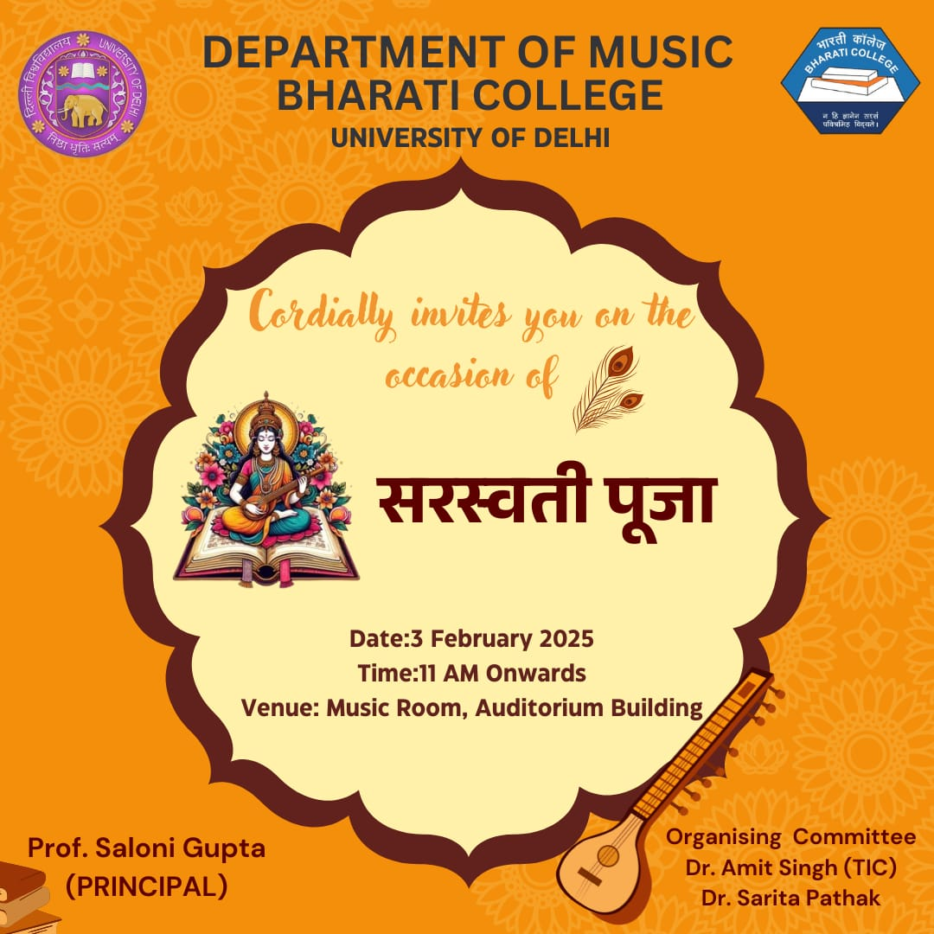
Saraswati Pooja (Basant Panchami)

Slide 11
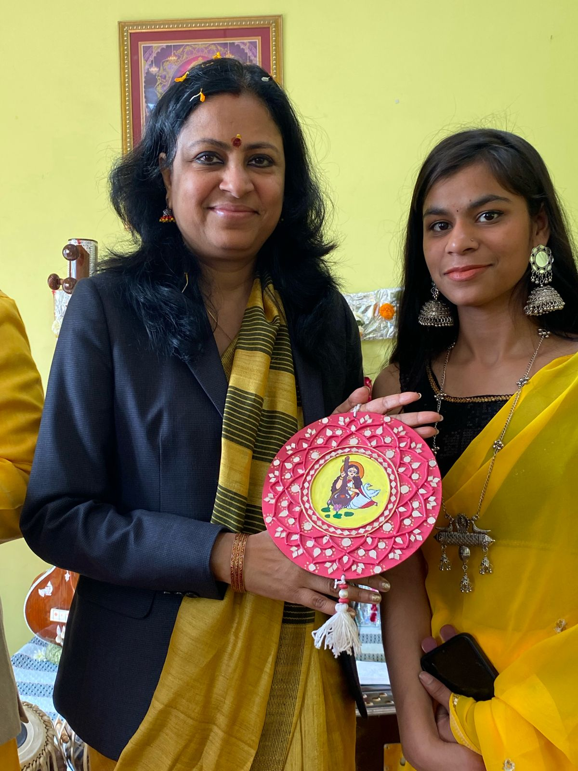
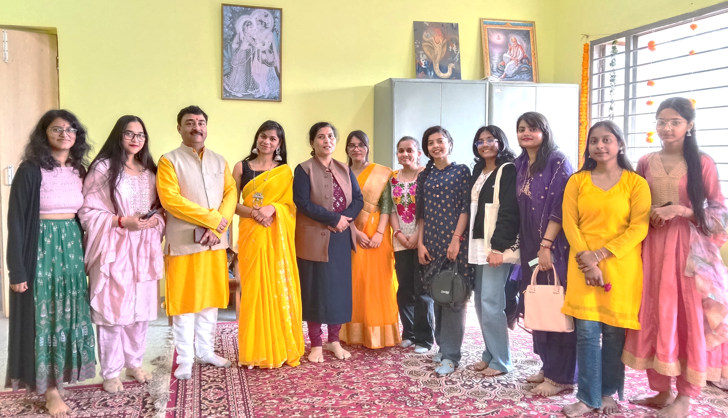
Saraswati Pooja (Basant Panchami)

Slide 12
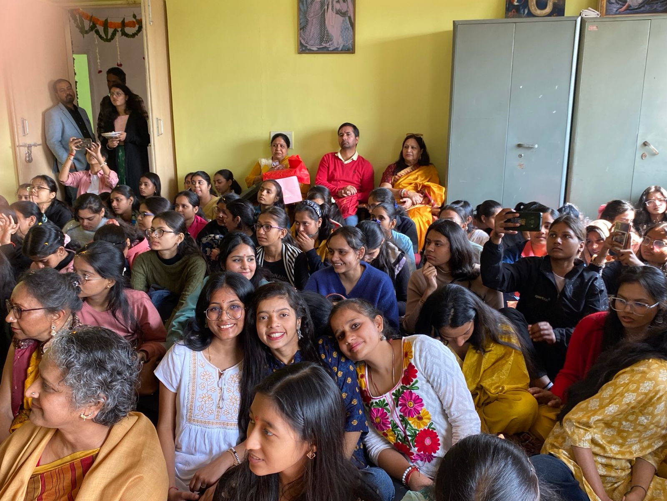
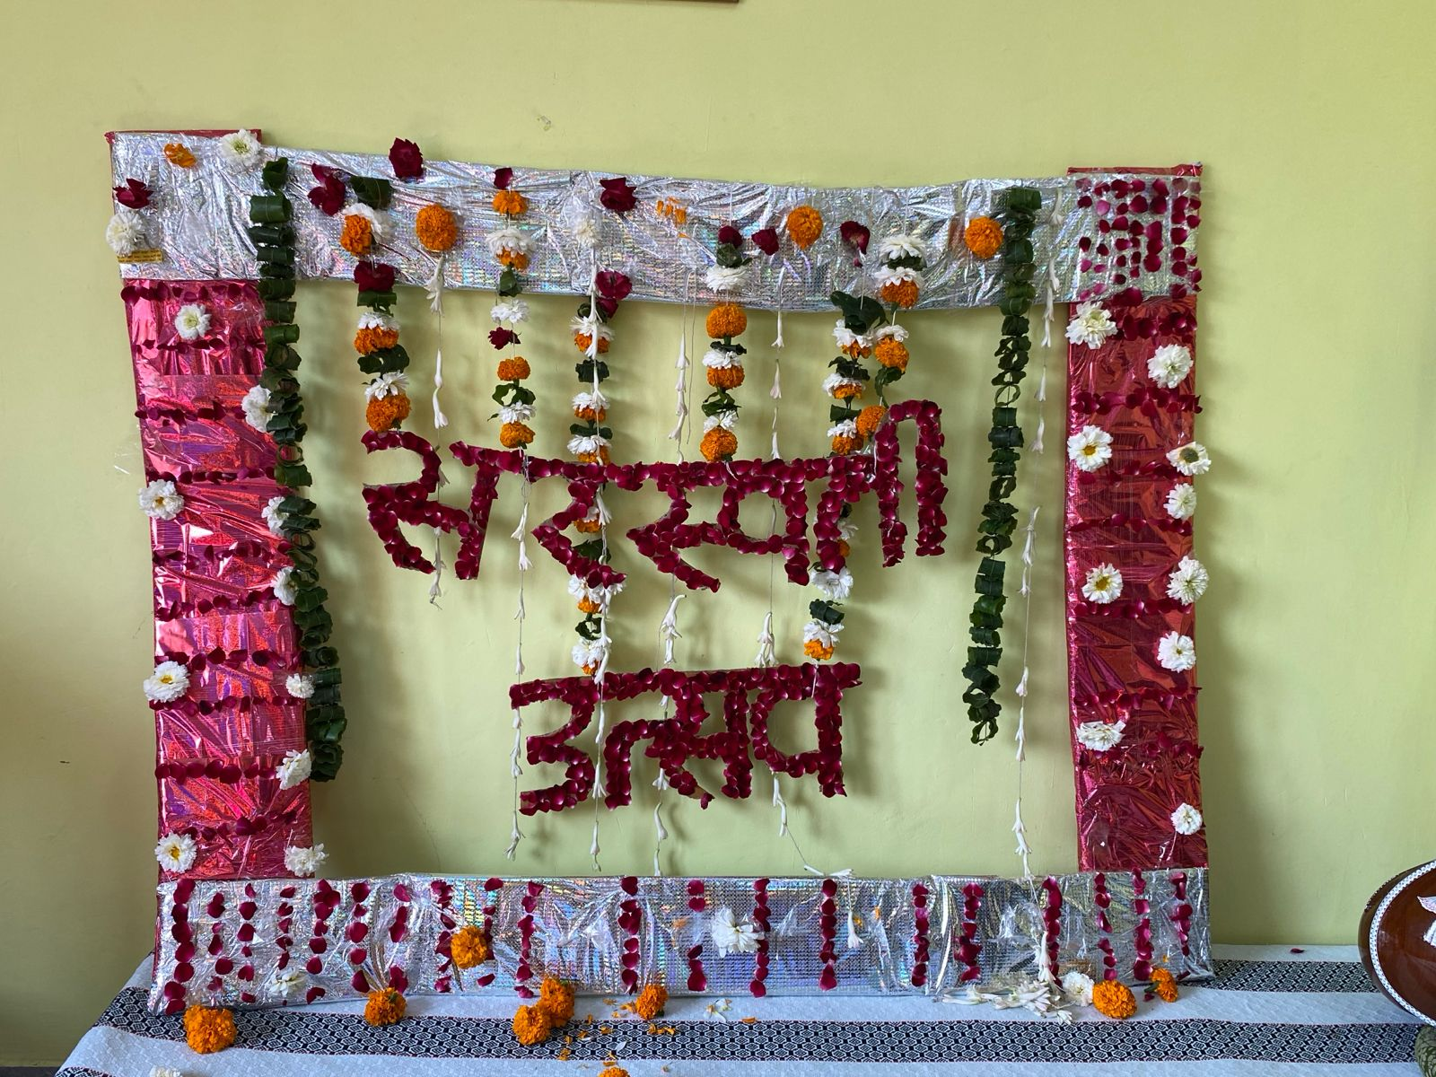
Saraswati Pooja (Basant Panchami)

Slide 13
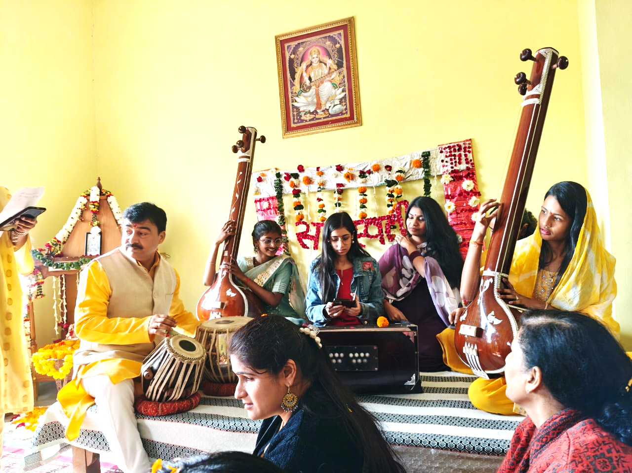
Saraswati Pooja (Basant Panchami)

Slide 14
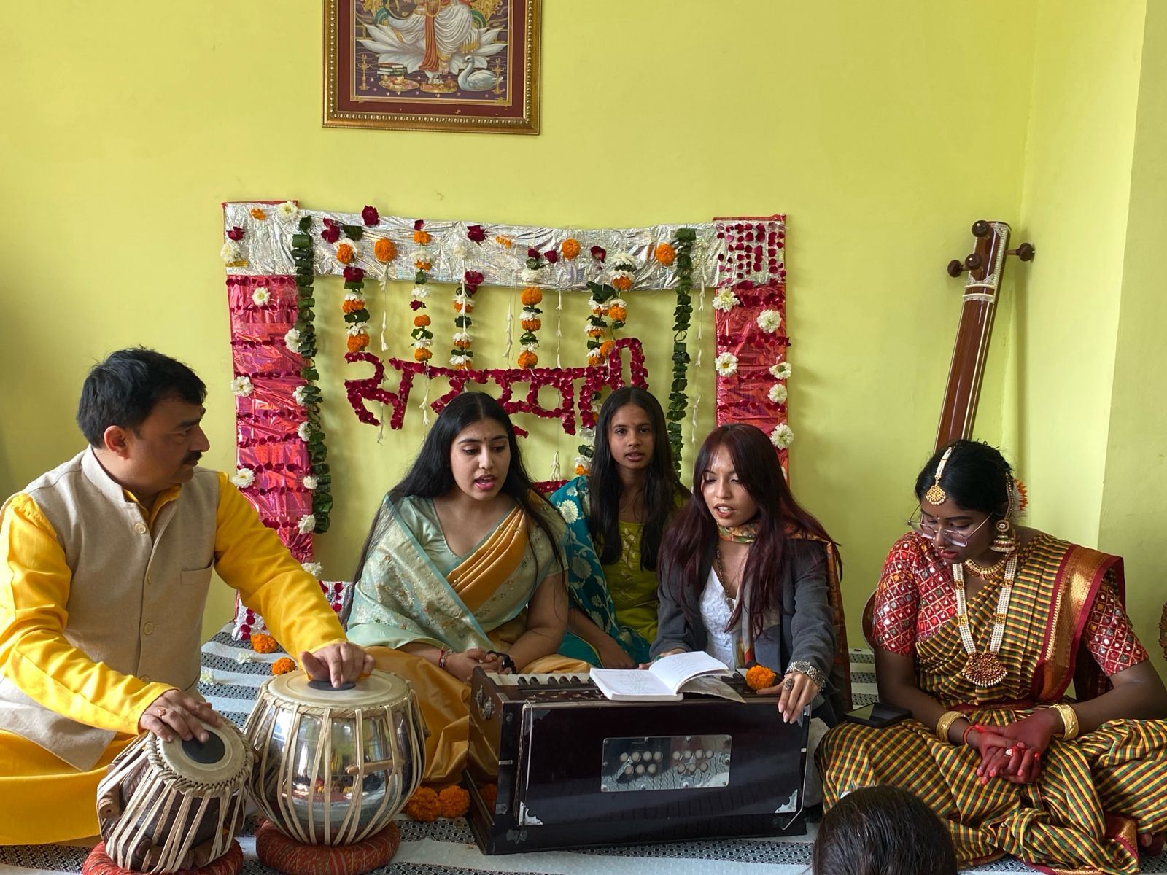
Saraswati Pooja (Basant Panchami)

Slide 15
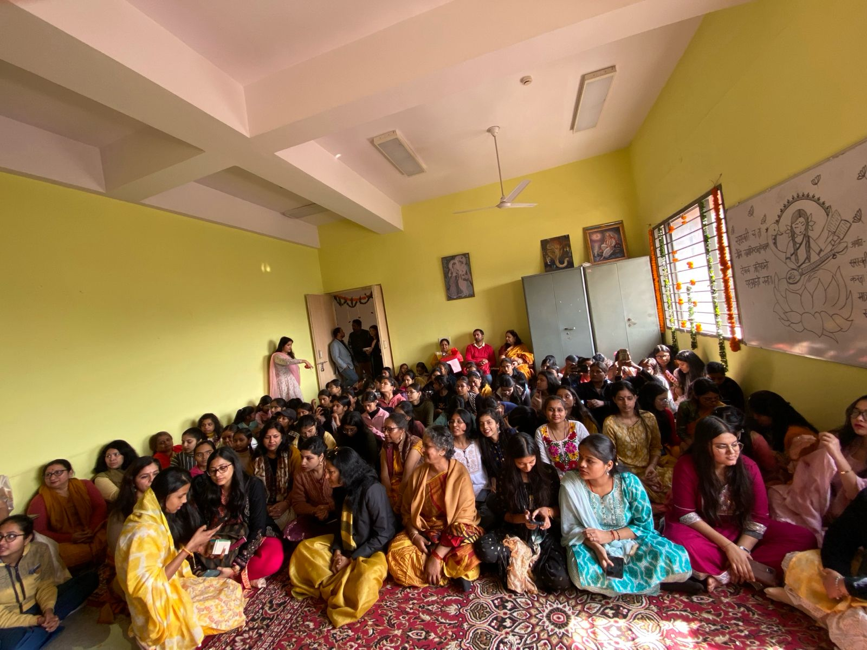
Saraswati Pooja (Basant Panchami)

Slide 16
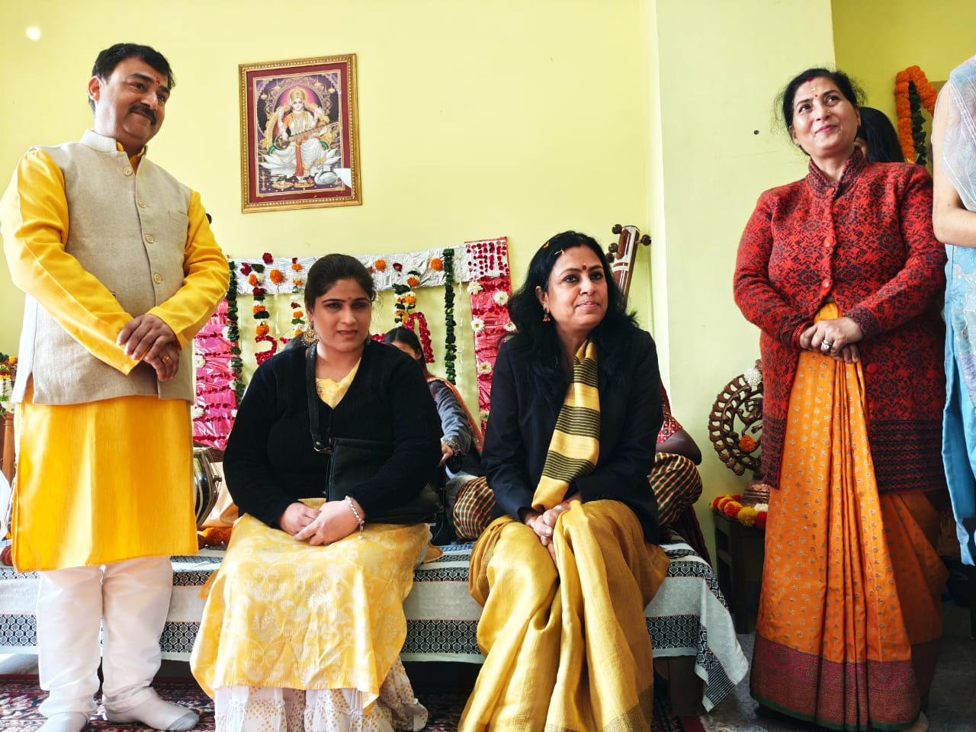
Saraswati Pooja (Basant Panchami)

Slide 17
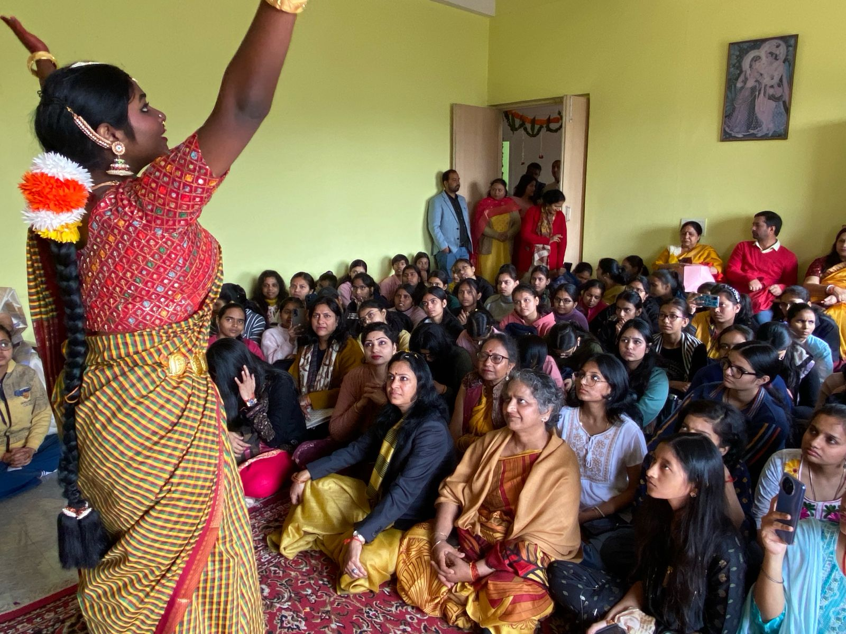
Saraswati Pooja (Basant Panchami)

Slide 18
Saraswati Pooja (Basant Panchami)

Slide 19
Saraswati Pooja (Basant Panchami)
Basant Panchami Celebration – Department of Music Date: 3rd February 2025
The Department of Music celebrated Basant Panchami on 3rd February 2025 with great devotion and cultural fervor. This vibrant festival marks the end of winter and welcomes the arrival of spring. It is dedicated to Goddess Saraswati, the divine symbol of knowledge, wisdom, and the fine arts. The color yellow, representing joy, prosperity, and positivity, was the theme of the day.
The venue was beautifully decorated with bright flowers and colorful drapes, creating an uplifting and festive ambiance. The Saraswati Mandir was adorned with garlands, and fruits were offered during the ceremonial pooja. The celebration began with a prayer, invoking the blessings of Goddess Saraswati.
The event was graced by the presence of Principal Professor Saloni Gupta and faculty members from various departments. The highlight of the day was a series of soul-stirring performances by students of the Department of Music. Through melodious ragas, rhythmic compositions, and graceful vocals, students showcased the richness, depth, and elegance of Indian Classical Music.
The event concluded with the distribution of prasad and a vote of thanks by the host. It was a truly enlightening and harmonious celebration of tradition, learning, and music.

Slide 20
LECTURE-CUM-PERFORMANCE ON Dhrupad Style of Singing
The Department of Music, Bharati College, University of Delhi, organized a highly enriching Lecture Demonstration on the Dhrupad style of singing on 3rd April 2025 at 11:30 AM in the Music Room (Auditorium Building). The session was conducted by the esteemed Pt. Ram ji Mishra, a renowned classical vocalist known for his expertise in the Dhrupad tradition.
The event was graced by our respected Principal, Prof. Saloni Gupta, whose presence encouraged and inspired the students and faculty alike. The demonstration offered a deep insight into the nuances of the ancient and meditative Dhrupad style, enriching the students' understanding of classical music beyond theoretical knowledge.
As the Teacher-in-Charge and Convener, Dr. Amit Singh, along with Co-Convener Dr. Sarita Pathak Yajurvedi, facilitated the smooth execution of the event. Their dedicated coordination ensured active participation and engagement from students.
The session had a significant impact on the students, igniting their interest in traditional music forms and motivating them to explore and preserve classical Indian music. The interactive demonstration provided a rare opportunity for students to learn directly from a maestro, leaving them inspired and more culturally rooted in their musical journey.

Slide 21
LECTURE-CUM-PERFORMANCE ON Dhrupad Style of Singing

Slide 22
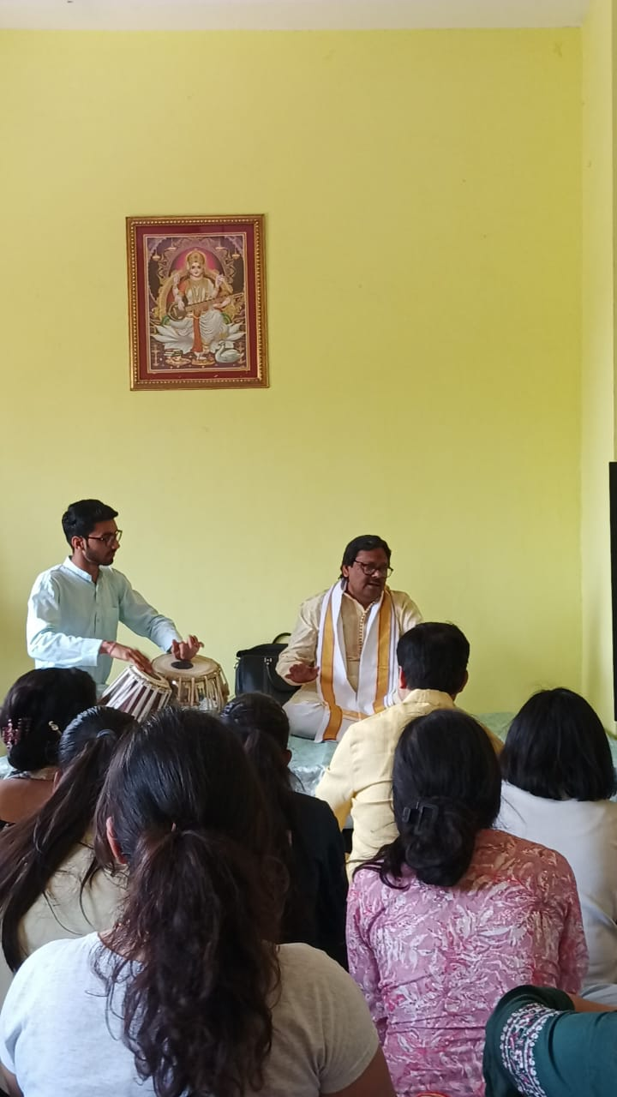
LECTURE-CUM-PERFORMANCE ON Dhrupad Style of Singing

Slide 23
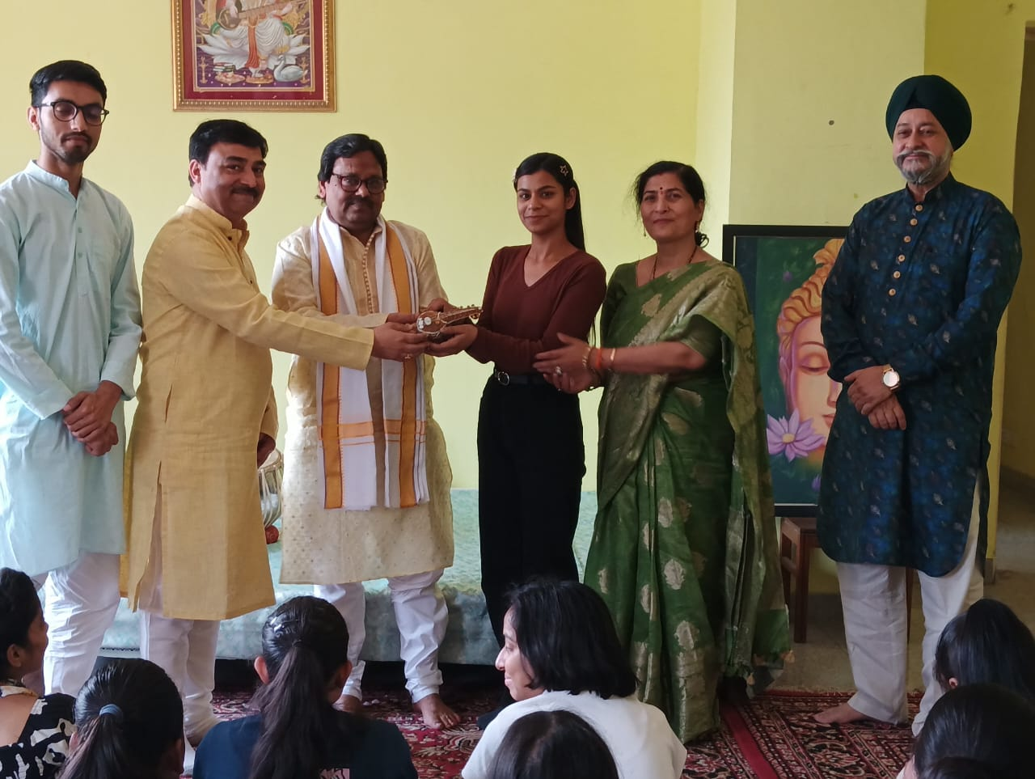
LECTURE-CUM-PERFORMANCE ON Dhrupad Style of Singing

Slide 24
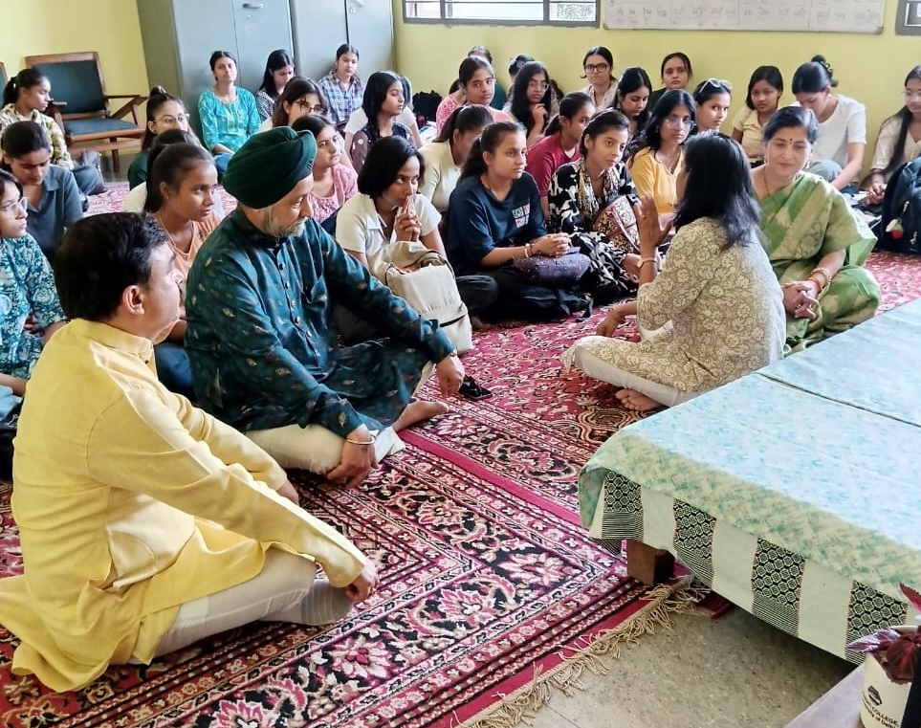
LECTURE-CUM-PERFORMANCE ON Dhrupad Style of Singing

Slide 25
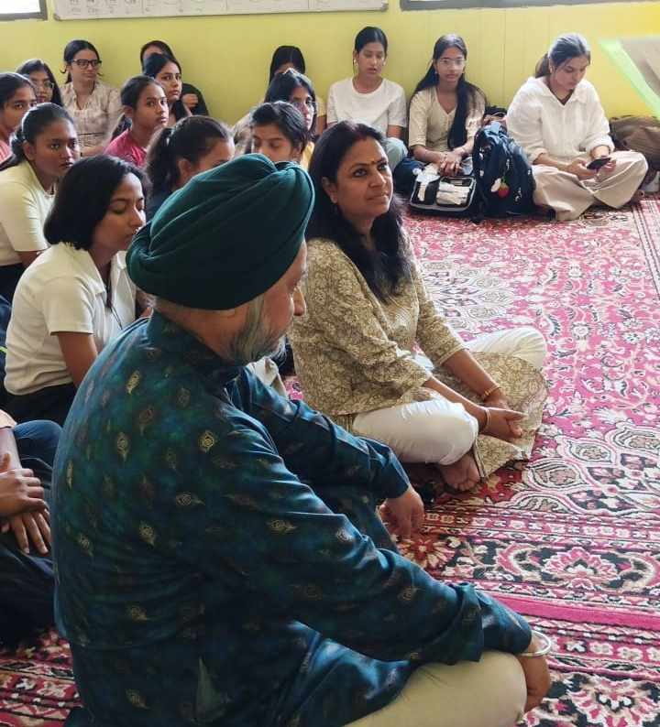
LECTURE-CUM-PERFORMANCE ON Dhrupad Style of Singing

Slide 26
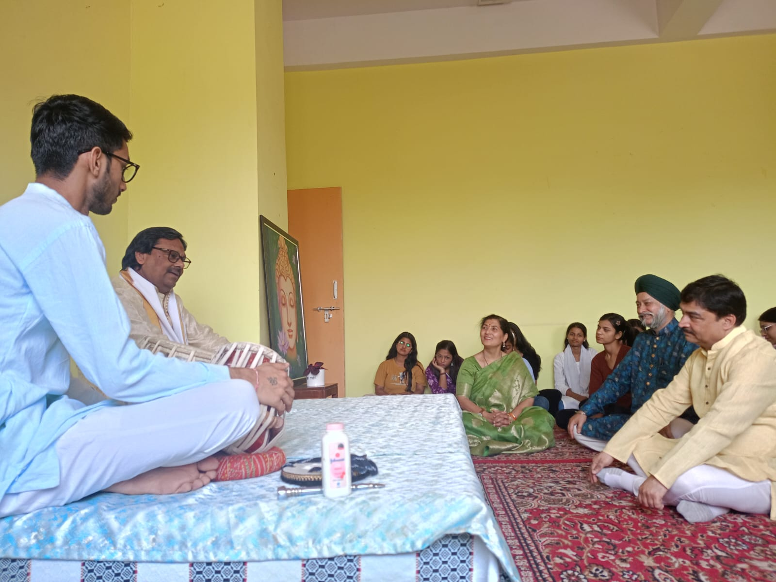
LECTURE-CUM-PERFORMANCE ON Dhrupad Style of Singing

Slide 27
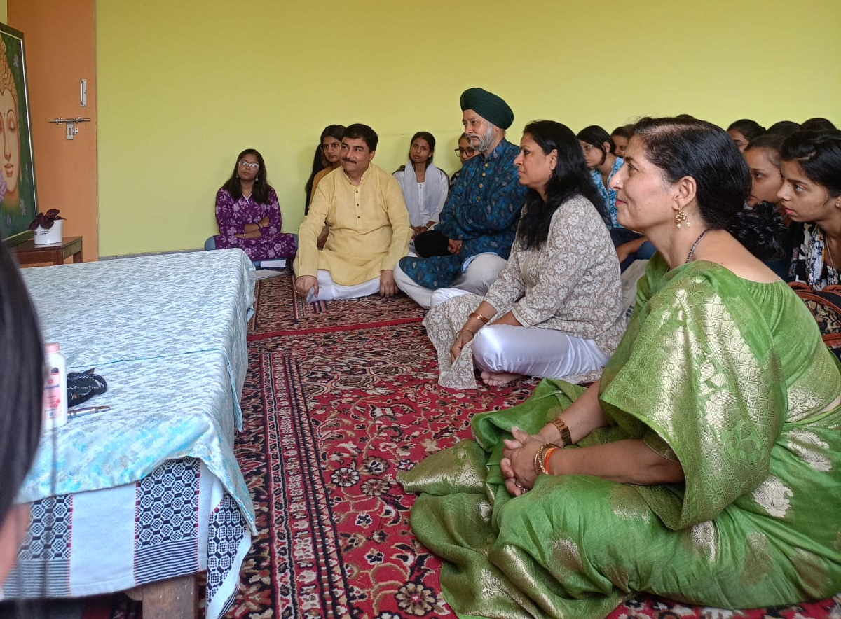
LECTURE-CUM-PERFORMANCE ON Dhrupad Style of Singing

Slide 28
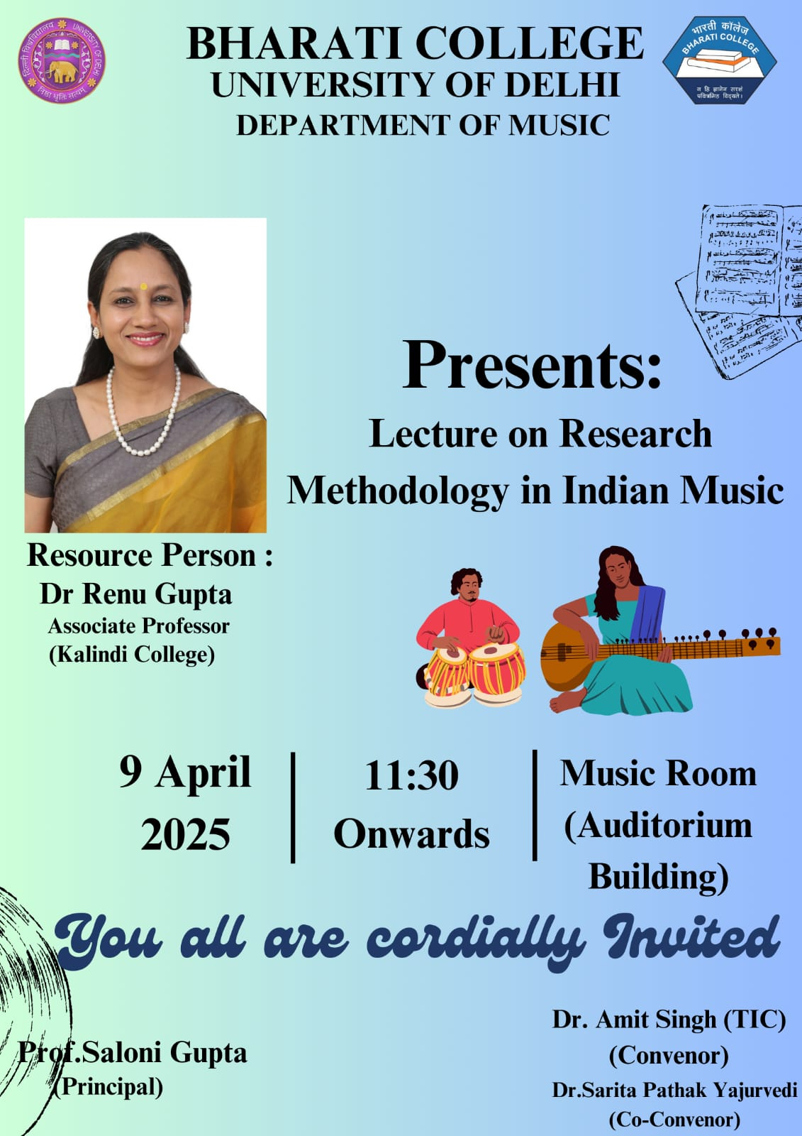
Lecture on Research Methodology in Indian Music

Slide 29
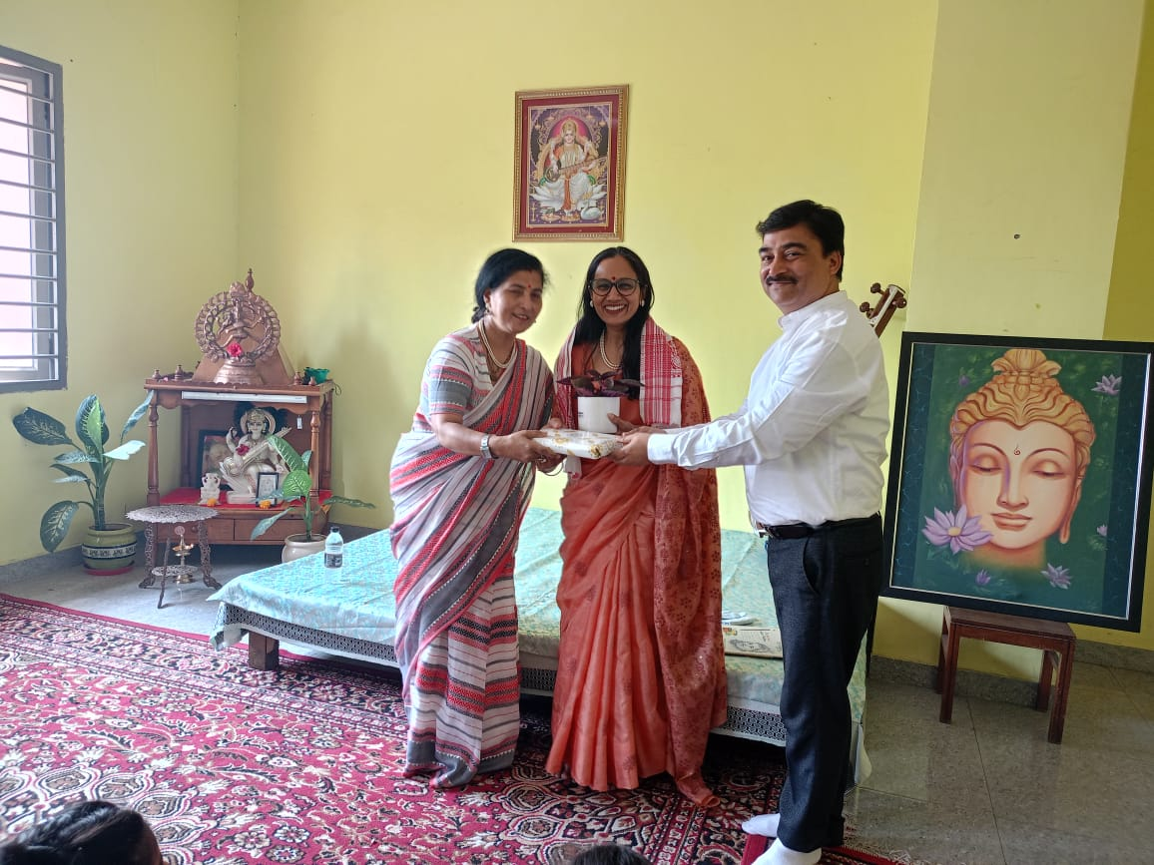
Lecture on Research Methodology in Indian Music

Slide 30
Lecture on Research Methodology in Indian Music
The Department of Music, Bharati College, University of Delhi, organized an insightful and academically enriching lecture on Research Methodology in Indian Music on 9th April 2025 at 11:30 AM in the Music Room, Auditorium Building. The session was conducted by the distinguished Dr. Renu Gupta, Associate Professor from Kalindi College, University of Delhi, who has made significant contributions to the field of musicology and research in Indian classical music.
The event commenced with a warm welcome by the Teacher-in-Charge and Convenor, Dr. Amit Singh, who emphasized the importance of incorporating rigorous research practices in music studies. The Principal of Bharati College, Prof. Saloni Gupta, graced the occasion and offered her encouraging words, highlighting the growing need for academic inquiry and innovation in the performing arts. Dr. Sarita Pathak Yajurvedi, the Co-Convenor, also extended her support and contributed to the smooth coordination of the event.

Slide 31
Lecture on Research Methodology in Indian Music
Dr. Renu Gupta delivered a comprehensive lecture on research methodology, covering key areas such as topic selection, literature review, fieldwork, data collection techniques, and documentation methods, specifically in the context of Indian classical music. She also shed light on the challenges faced by researchers in this domain and provided practical guidance to overcome them.
The session had a profound impact on the students, particularly those pursuing postgraduate studies and research-oriented careers. It provided them with a clear roadmap to undertake systematic and meaningful research projects. The interactive nature of the lecture allowed students to engage with the speaker directly, clarifying doubts and gaining a deeper understanding of the subject matter.
Overall, the lecture proved to be a valuable academic experience, enhancing the research aptitude of the students and reinforcing the department's commitment to blending performance with scholarship.

Slide 32
Shivoham: Hours of Awakening
On the occasion of Mahashivratri, Prajna Pravah, in collaboration with the University of Delhi, organized a grand cultural initiative titled Shivoham: Hours of Awakening on 26th–27th February 2025 at Satyagrah Mandap, Gandhi Smriti, Raj Ghat. As part of the lead-up to this 24-hour spiritual and cultural celebration, a series of pre-events were conducted, one of which was the Devotional Song and Dance competition held on 20th February 2025 at Bharati College.
Students from the Department of Music, Bharati College, actively participated in the Pre-Shivoham event under the guidance and encouragement of Dr. Amit Singh, Teacher-in-Charge of the department. The theme of the event, “शिव-शक्ति: सृष्टि एवं सृजन”, inspired students to explore and present creative expressions of devotion through traditional music and dance forms.
.

Slide 33
Shivoham: Hours of Awakening
The participation of our students proved to be an enriching experience. Engaging in devotional performances not only deepened their understanding of Indian spiritual traditions but also enhanced their stage presence and collaborative skills. Their performances received enthusiastic appreciation from both the audience and jury, boosting their confidence and reinforcing the importance of integrating cultural values with artistic practice.
The event was conducted under the esteemed patronage of Prof. Saloni Gupta, Principal of Bharati College, whose consistent support fosters a vibrant cultural atmosphere on campus. Coordinators Dr. Ajit Kumar and Dr. Ankita Chauhan ensured the smooth execution of the event, along with student coordinators Tanu Shree Pandey and Raojalin Dash.
Overall, the event made a profound impact on the students, helping them grow artistically and spiritually while representing the college with excellence and devotion on an inter-collegiate platform

Slide 34
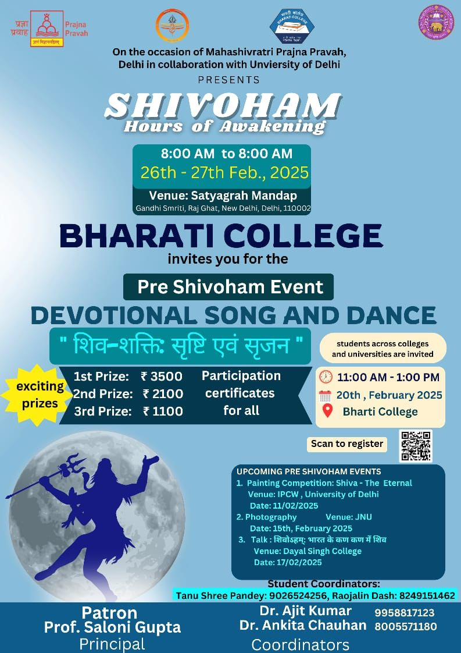
Shivoham: Hours of Awakening

Slide 35
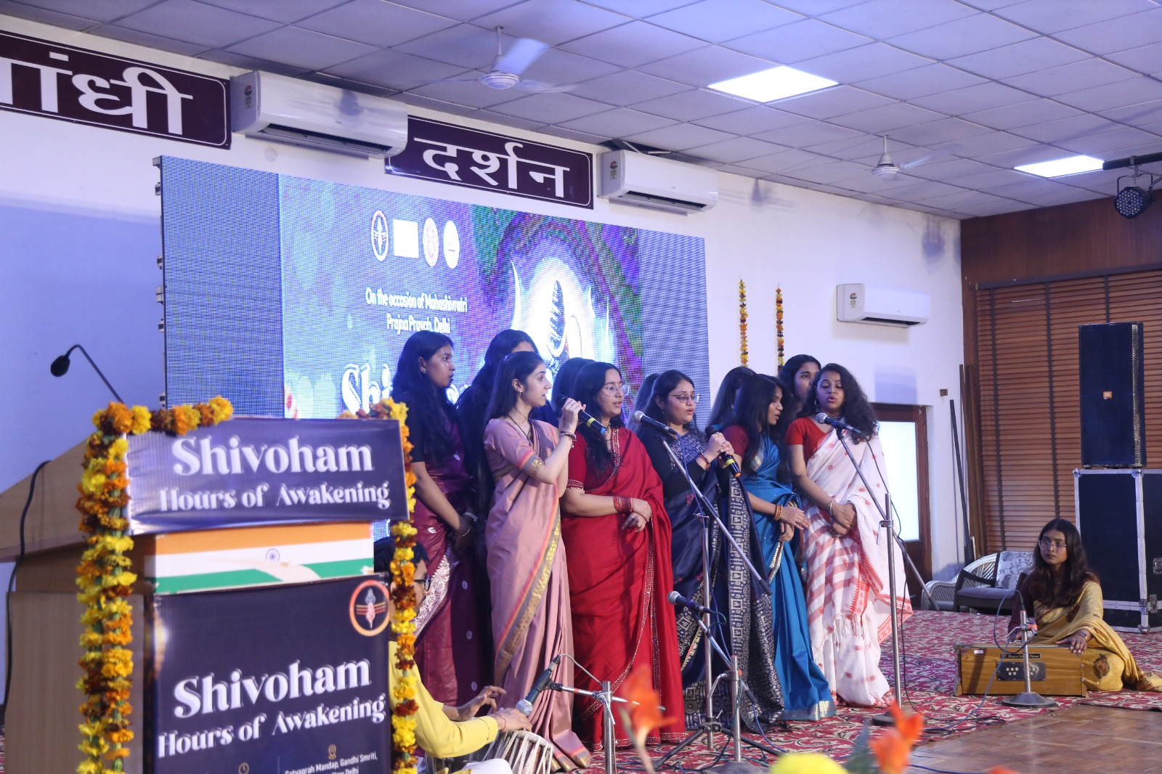
Shivoham: Hours of Awakening

Slide 36
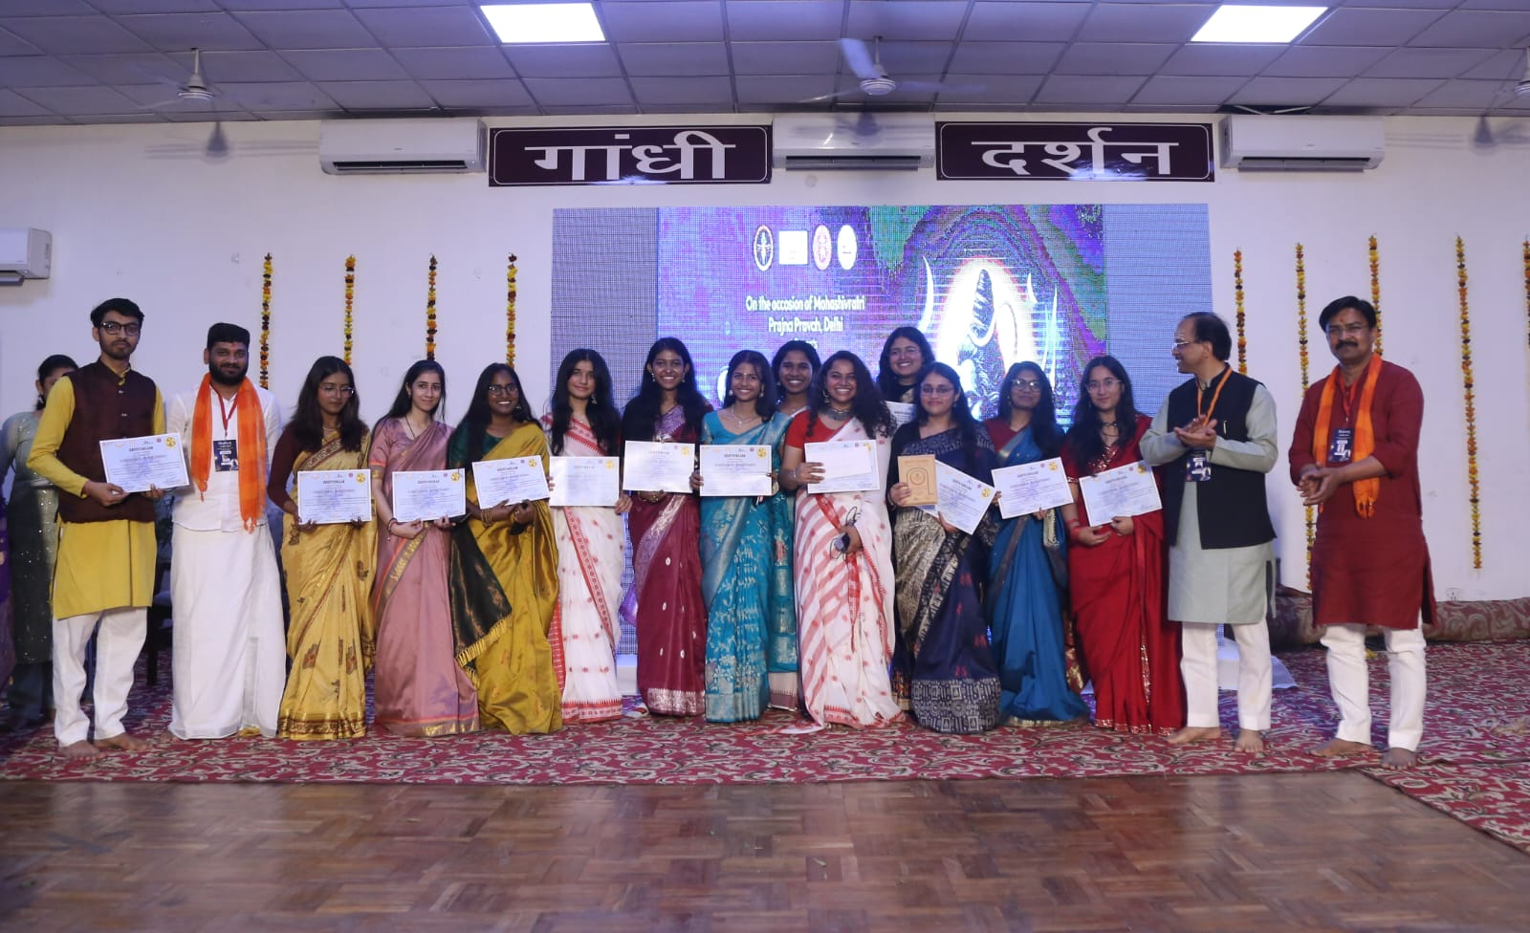
Shivoham: Hours of Awakening

Slide 37
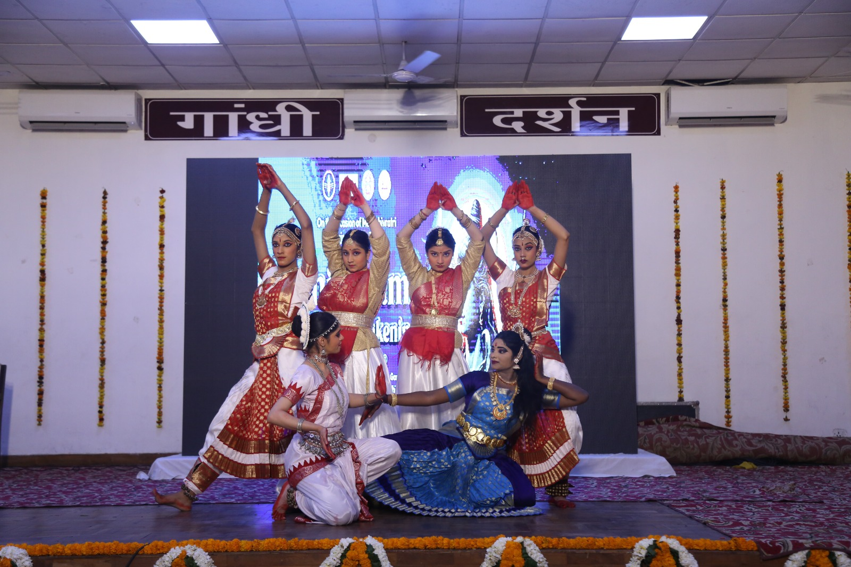
Shivoham: Hours of Awakening

Slide 38
Shivoham: Hours of Awakening

Slide 39
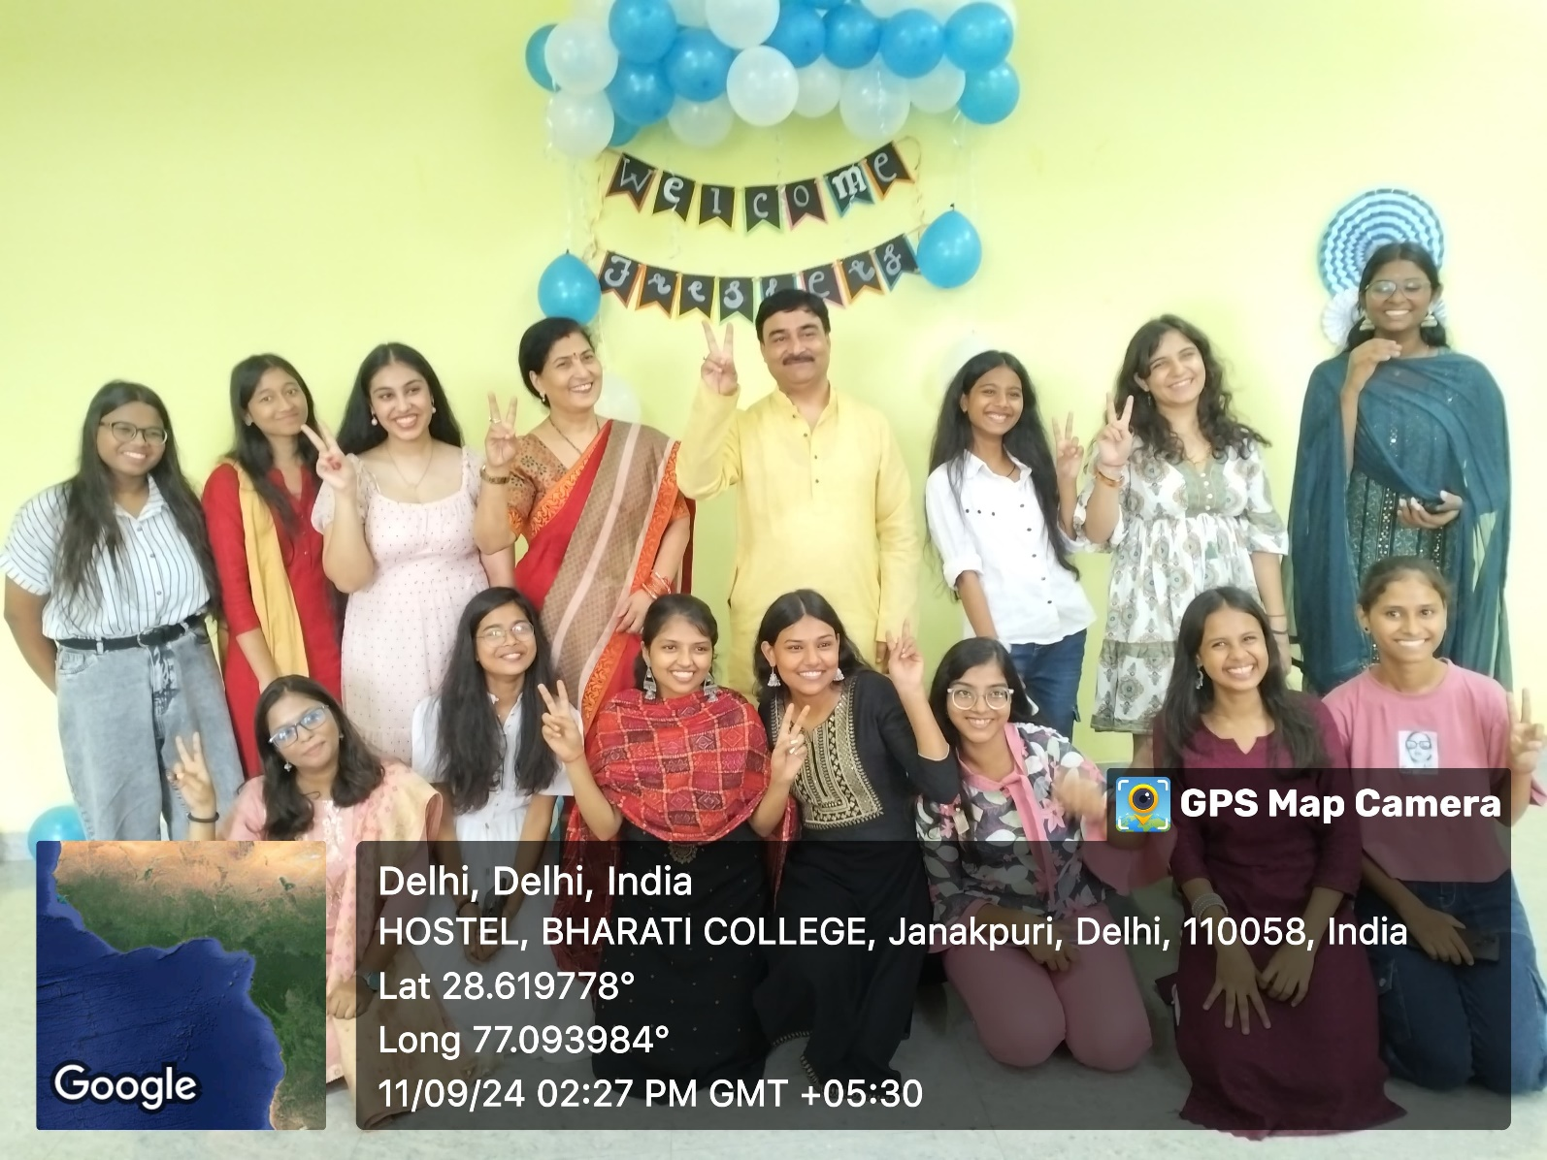
Fresher’s Welcome
Date: 11th September 2024
Starting college can be overwhelming. A Freshers' Welcome helps students feel more comfortable in their new environment and reduces anxiety by offering a friendly and inclusive start.

Slide 40
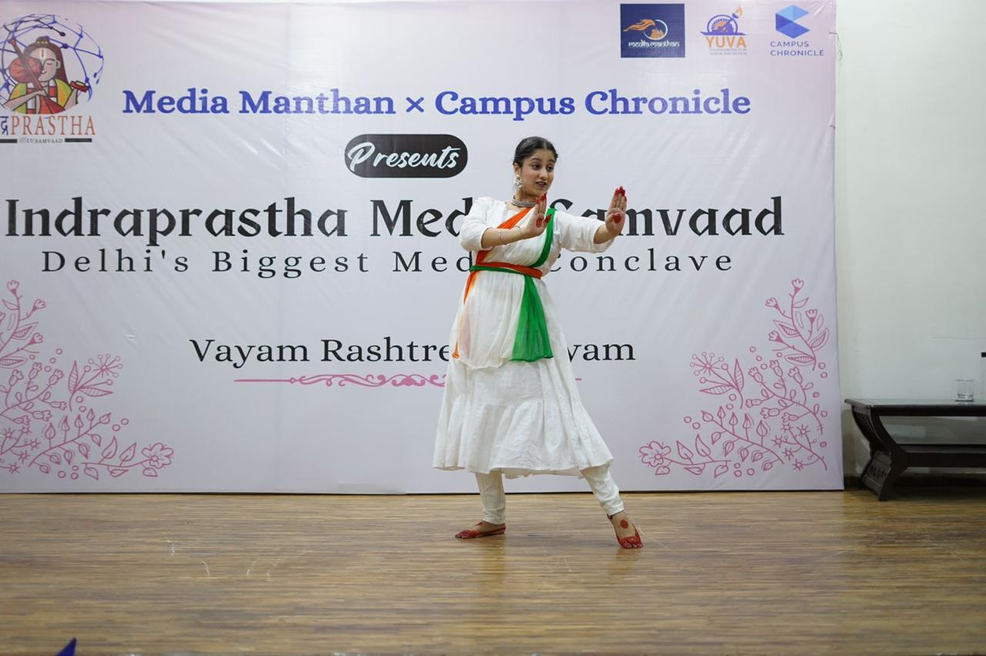
Students Performances and Events
Date – 21st May 2024
Reedhima Chhabra Performed in Indraprastha Media Samvad and received a badge for cultural convenor of the Media Manthan Team of Bharati College

Slide 41
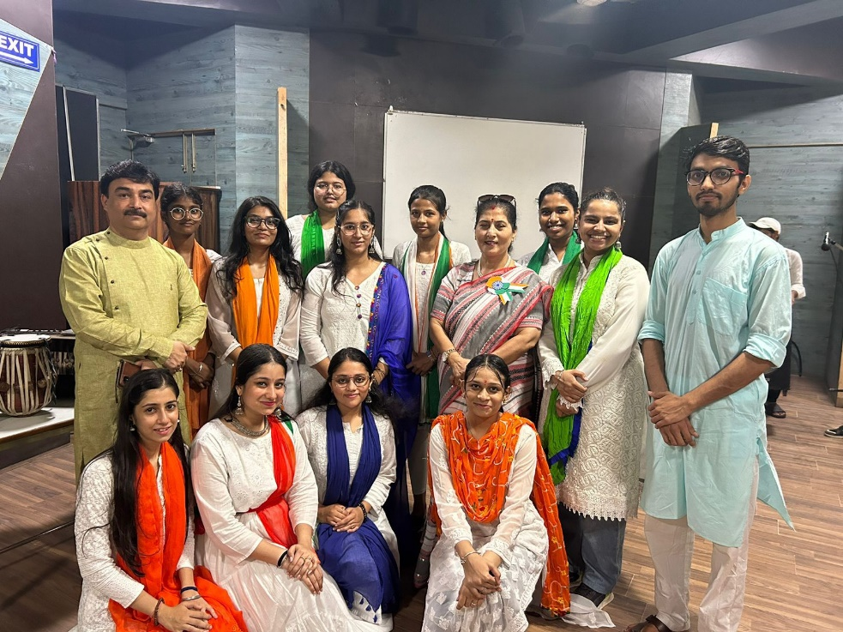
Students Performances and Events
Date – 15th August 2024
Singers and Dancers performed at the Independence Day Event
Songs: Vande Mataram, Dil diya hai jaan bhi denge, National Anthem
Singers: Bhumi Sharma, Sashu Katoch, Parvi Khurana, Christina, Shobhika, Vaishnavi, Tanvi, Yogya, Archana
Dancer: Reedhima Chhabra

Slide 42
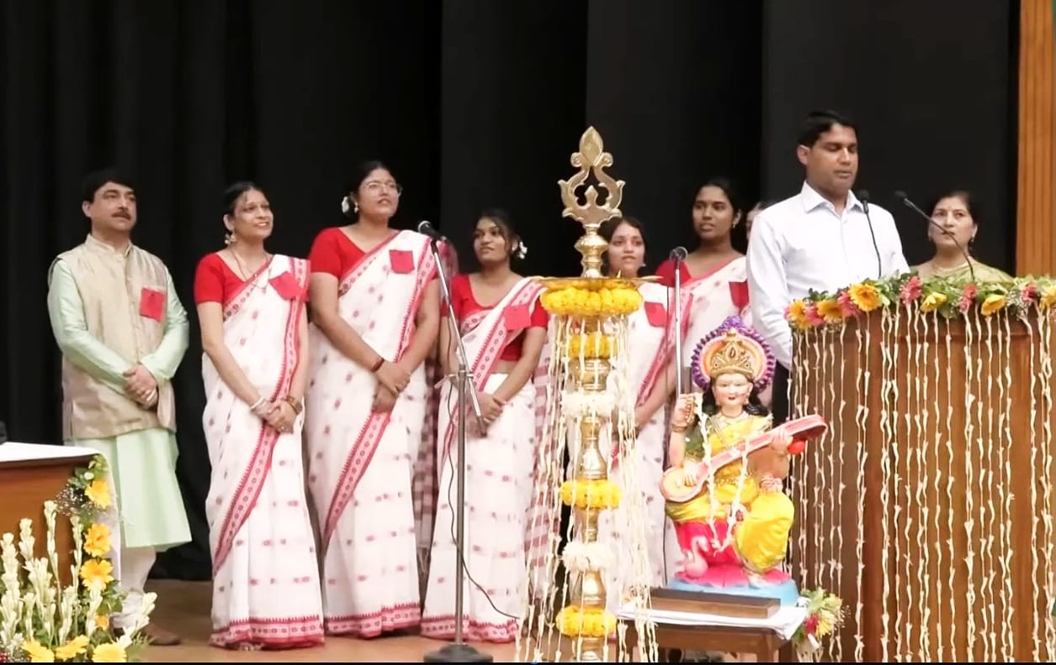
Students Performances and Events
Date – 30th August 2024
Singers performed at an Event where the Vice President of India addressed the students of Bharati College on “The Role of Women in Viksit Bharat.”
Song: Kulgeet, Saraswati Vandana, National Anthem
Singers: Bhumi Sharma, Tanvi, Sashu Katoch, Vaishnavi, Shobhika, Christina

Slide 43
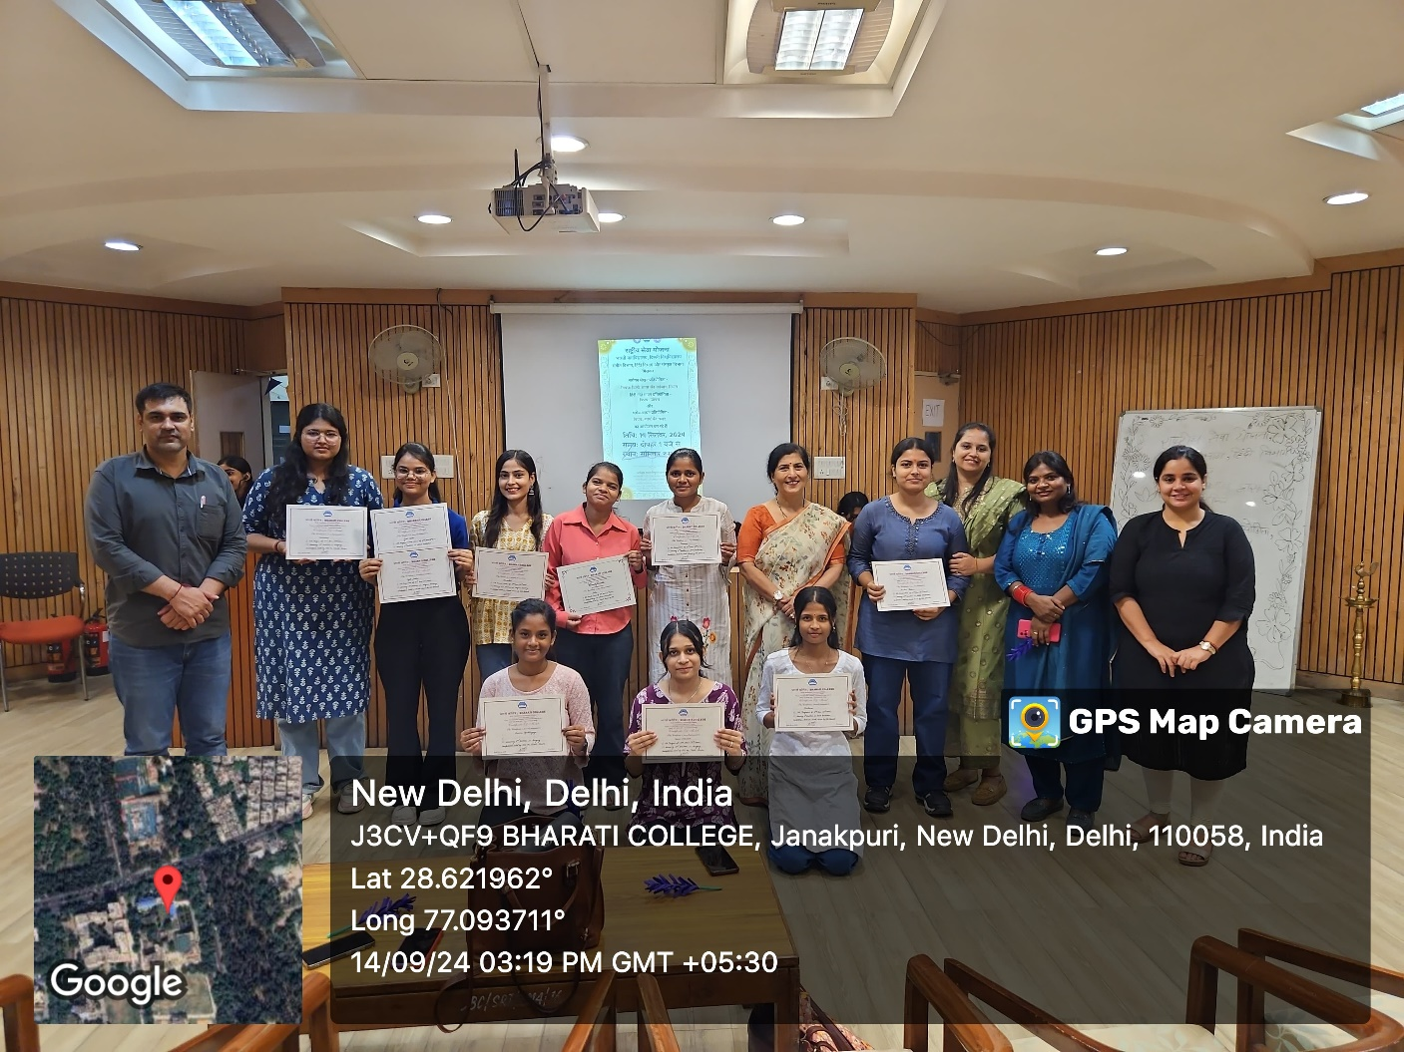
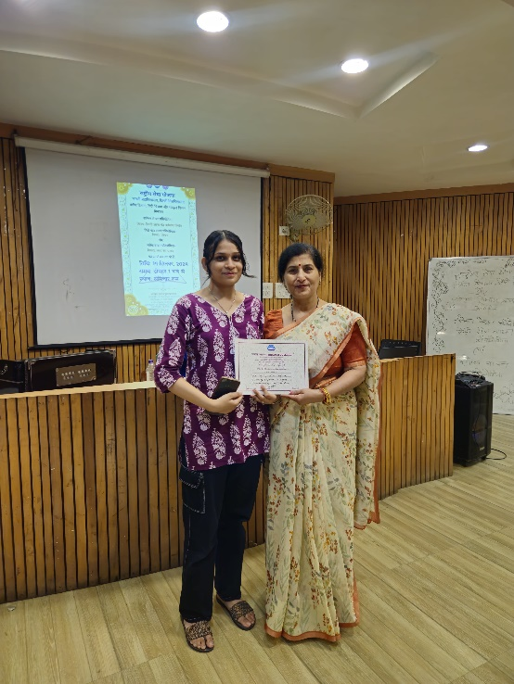
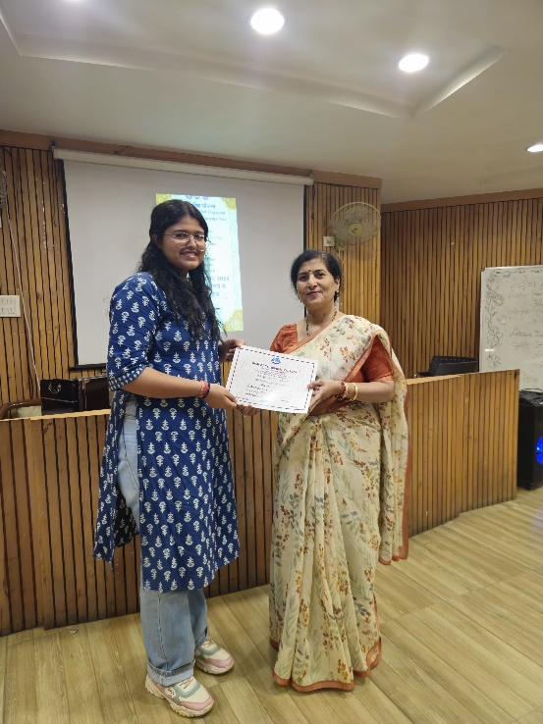
Students Performances and Events
Date – 14th September 2024
Vaishnavi Tiwari and Tanvi Chauhan participated in a Singing Competition organized by NSS on Hindi Diwas
Vaishnavi secured First Position and Tanvi secured Third Position

Slide 44
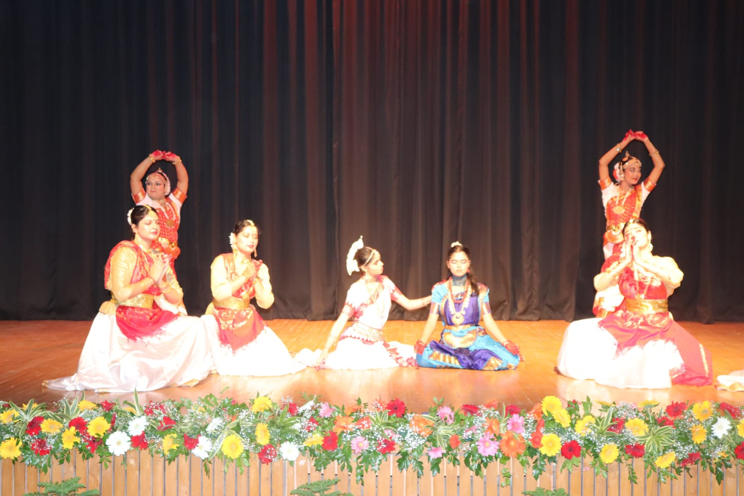
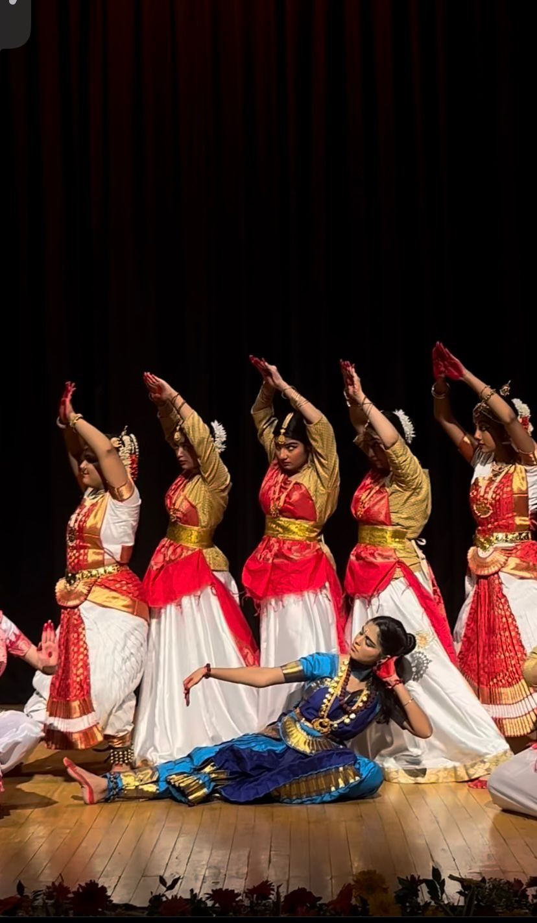
Students Performances and Events
Date – 20th September 2024
Singers and Dancers performed in the Annual Day 2024
Song: Saraswati Vandana, Kulgeet
Singers: Priyanshi Rawat, Sashu Katoch, Bhumi Sharma, Christina, Shobhika, Mandira, Archana, Vaishnavi, Tanvi
Dancers: Diksha, Diya Jaiswal, Anushka, Bishita, Reedhima Chhabra, Samridhi, Pragati, Anshika

Slide 45
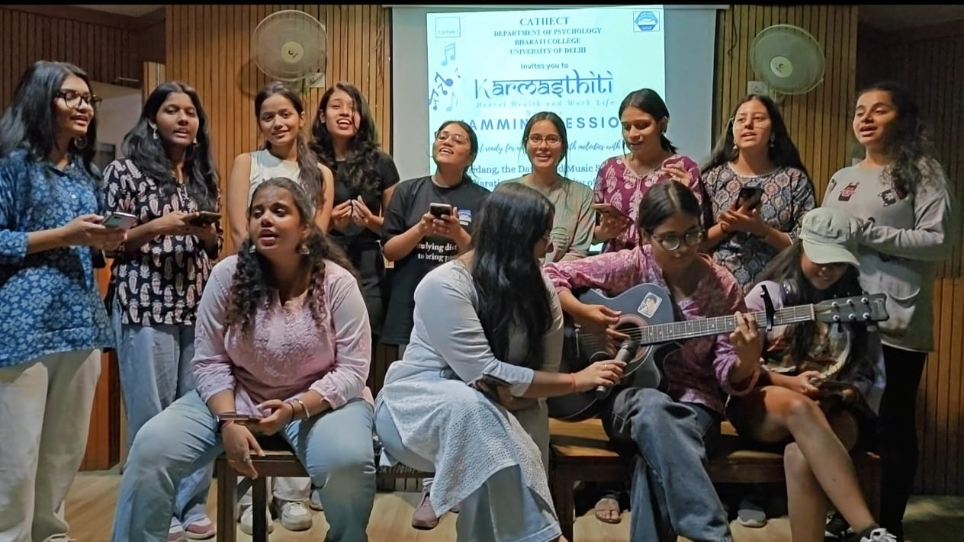
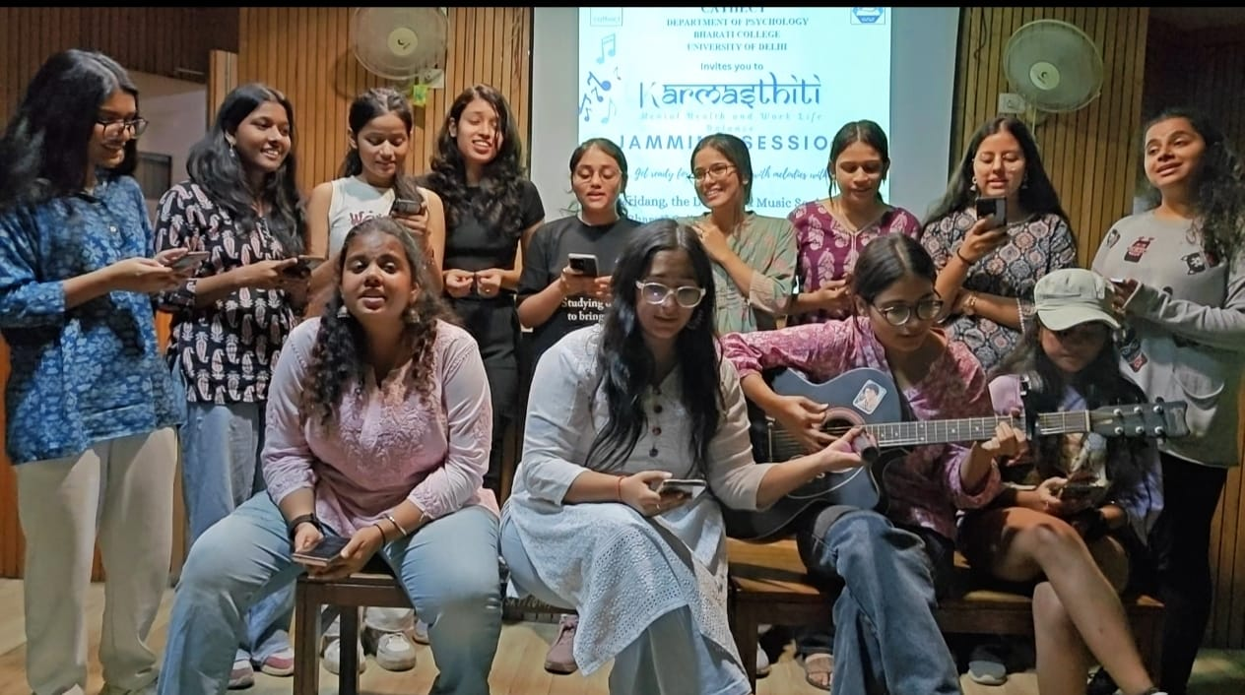
Students Performances and Events
Date – 15th October 2024
Singers performed in Karmastithi organized by the Psychology Department
Singers: Parvi, Sharanya, Tanvi, Priyanshi Rawat, Sashu Katoch, Pawni, Khushi, Ria, Shobhika, Parisha, Yogya, Ritika, Puru

Slide 46
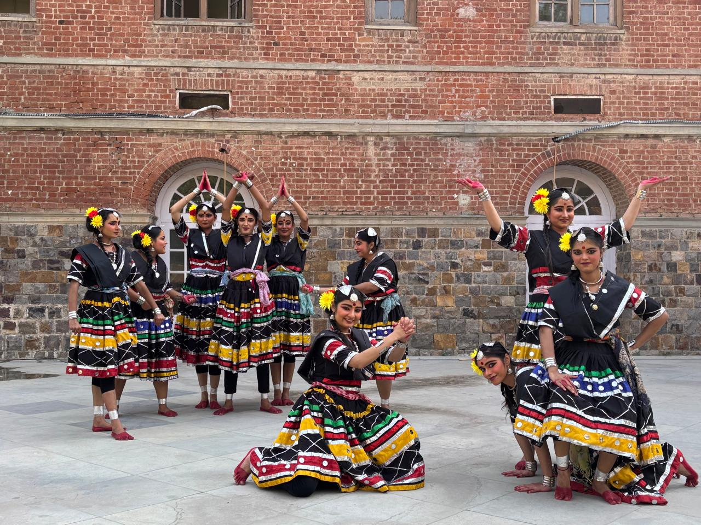
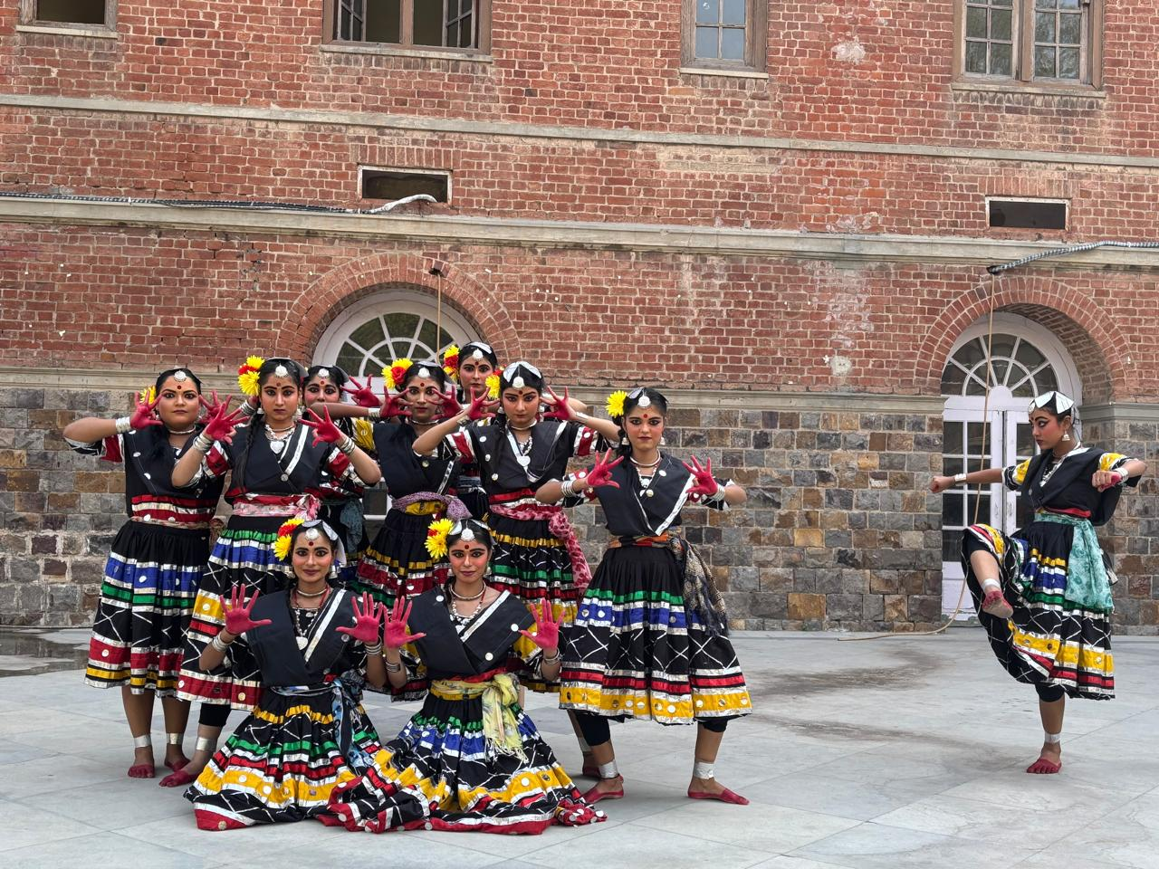
Students Performances and Events
15th October 2024
Dancers performed in the Youth Festival organized by the University of Delhi
Dancers: Bishita, Diya, Samridhi, Reedhima, Yamini, Lakshika, Anshika, Sukhmeet, Sakshi, Diksha

Slide 47
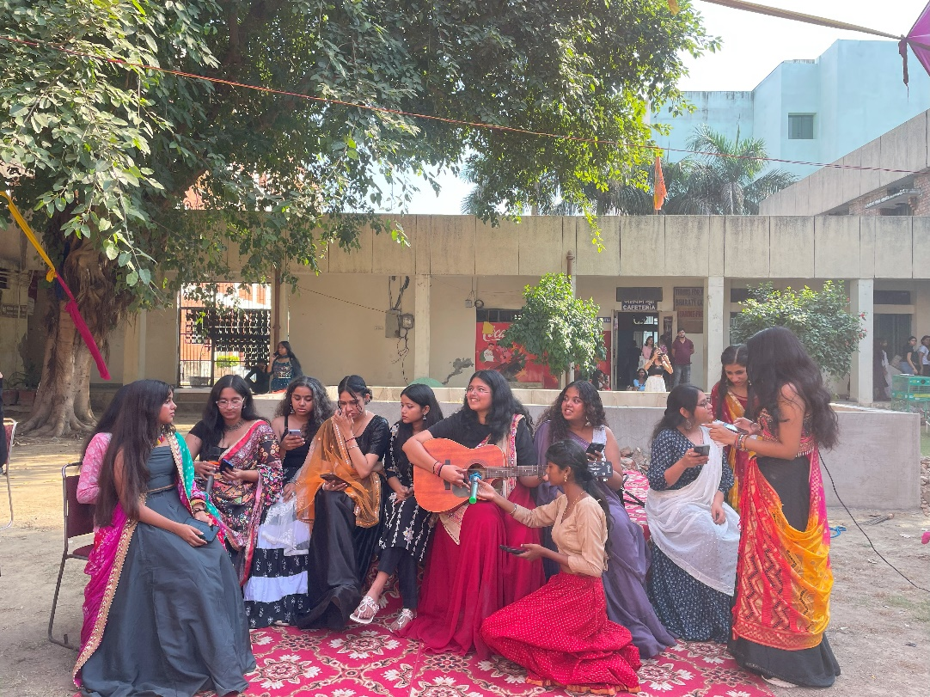
Students Performances and Events
Date – 19th October 2024
Singers performed in Dholida: The Garba Fest and Diwali Mela organized by Student Helpdesk
Singers: Shobhika, Bhumi Sharma, Sashu Katoch, Parisha, Vaishnavi, Khushi, Tanvi, Parvi, Yogya, Puru, Archana

Slide 48
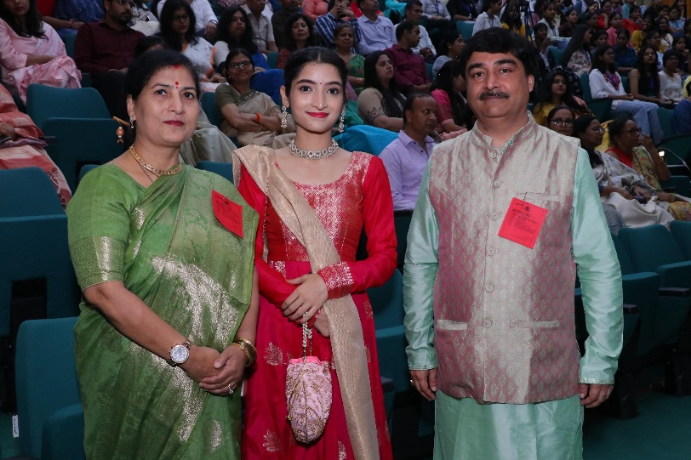
Students Performances and Events

Slide 49
MRIDANG – THE MUSIC AND DANCE SOCIETY
Convenor - Dr. Sarita Pathak Yajurvedi
Co-Convenor- Dr Amit Singh
Introduction – Welcome to the exciting world of our Music and Dance Society, Mridang! Here, rhythm meets melody, and creativity comes to life. Mridang is more than just a society—it’s a place where people who love music and dance come together to learn, grow, and share their passion.
We welcome everyone, whether they are an experienced performer or just starting out. Our society brings together members from different backgrounds and talents, creating a space where everyone can express themselves and connect with others. From classical tunes to modern beats, and graceful dance forms to energetic moves, we explore and celebrate it all.
At Mridang, it’s not just about performing—it’s about making memories, building friendships, and being part of a supportive community. We are on an artistic journey of music and dance, where every step and every note is a chance to create something beautiful!
President – Priyanshi Rawat
Vice President: Bishita Chakraborty
General Secretary: Sashu Katoch
Social Media Heads: Nandini Sri Paul, Sana Praveen
Dance Practice Heads: Diya Jaiswal, Sana Praveen

Slide 50
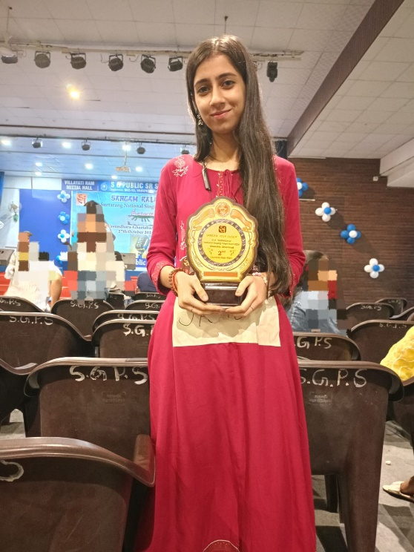
Students Performances and Events
Date - 22nd October 2024
Mridang Singers performed in a Seminar organized by the Hindi Department
Song: Saraswati Vandana
Singers: Sashu Katoch, Madhushree, Puru, Sharanya, Pawni
Date – 27th October 2024
Bhumi Sharma participated in Sangam Kala Group, 41st “Surtarang” National Singing Talent Hunt 2024 and secured Second Position (Junior) Non-Filmy Category
Date – 11th November 2024
Bhumi Sharma (Hindustani Vocal) and Vaishnavi Tiwari (Light Vocal) participated in the Inter-Department Music Competition organized by the University of Delhi
Date- 13th November 2024
Puru Khoba (Western Vocal) participated in the Inter-Department Music Competition organized by the University of Delhi
Date – 15th November 2024
Diksha Sen Participated in Vimarsh 2024 and secured 3rd position

Slide 51
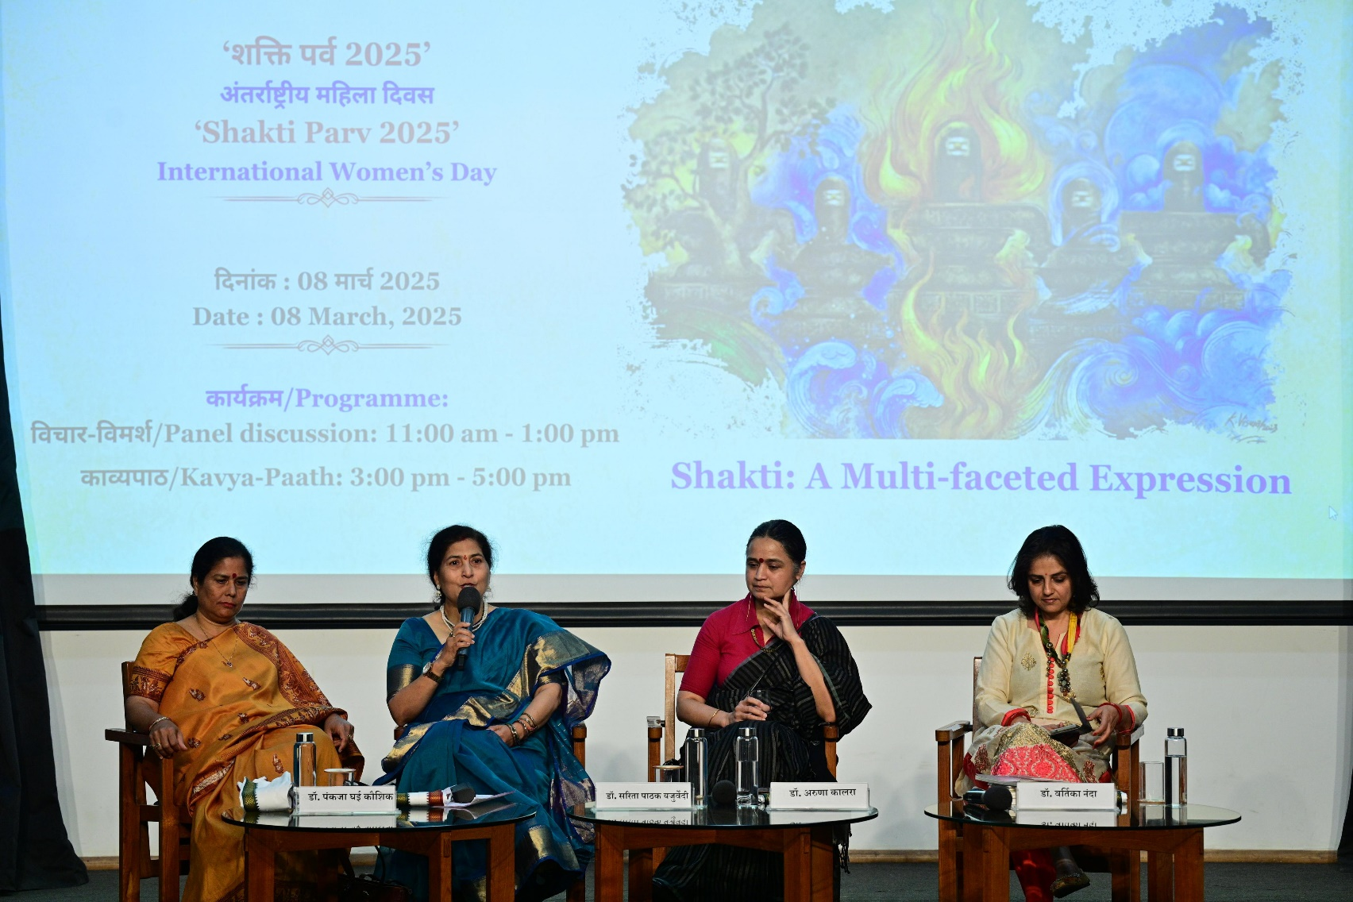
Achivements in 2024-2025

Slide 52
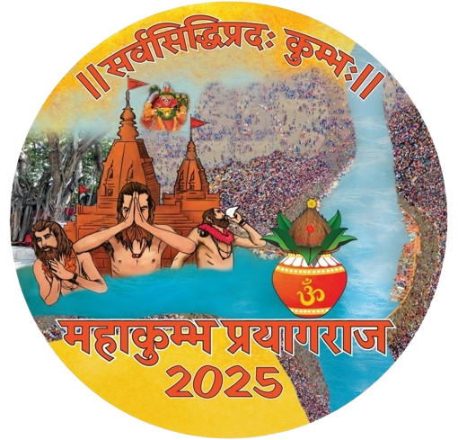
Achivements in 2024-2025

Slide 53
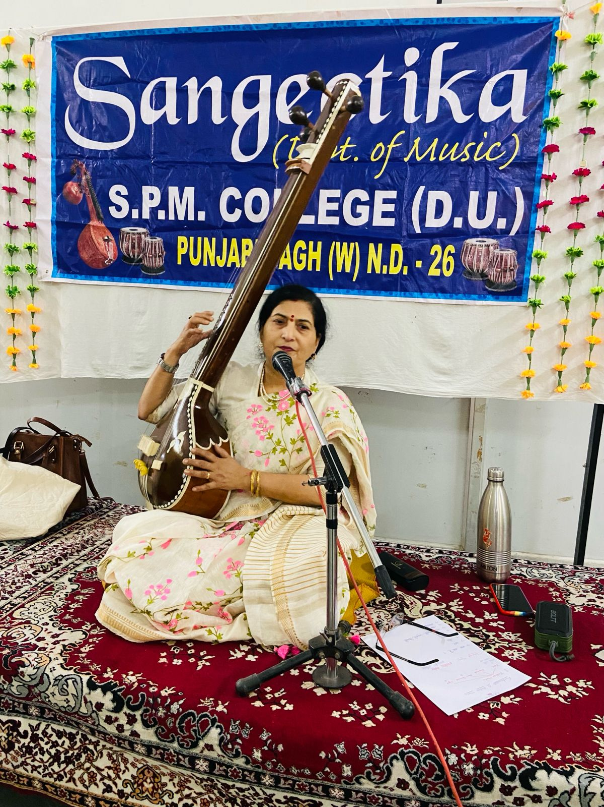
Achivements in 2024-2025

Slide 54
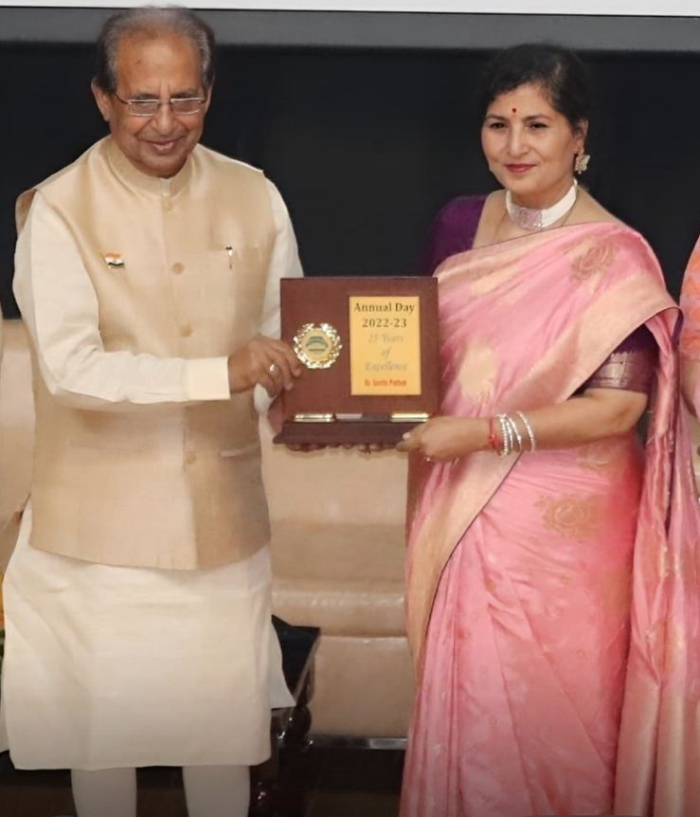
Achivements in 2024-2025

Slide 55
Achivements in 2024-2025
8/3/2025
Participated as panelist on the occasion of International Women's day organised by Indira Gandhi National Centre for Arts and Culture 's Shakti Parv-2025 under the theme of "Shakti A Multifaceted Expression ( शक्ति के विविध आयाम) on 8 th March,2025.
5/3/2025
Invited to be the Judge for
Lata Mangeshkar National Music Competition organised by SGND Khalsa College, University of Delhi on 5/3/2025.
31/01/2025
Invited by Consortium for Educational Communication as the Chairperson of the Jury constituted for 'Best Sound Design ' for their yearly "Educational Video Competition" in various Universities/ Institutions across India.
22/01/2025
Consortium for Educational Communication has invited to be the part of 'Subject Expert Group for Performing Arts' Organised by Ministry of Education through CEC "Subject Expert Group(SEG) meeting for vetting the Undergraduate Course Proposals Received.

Slide 56
Achivements in 2024-2025
15/01/2025
Invited to be the Judge for the Talent show Season 6 at Heromotocorp
21/22-11-2024
Attended two day National Seminar titled:"Tha Artistic Presentation of Ragas and Talas in various Classical Forms of Indian Music" organised by Department of Music, University of Delhi.
28/09/2924
Invited to be a member of the Selection Committee under the Cultural Talent Search Scholarship Scheme implemented by Centre For Cultural Resource and Training, Ministry of Culture,GOI.
26/09/2024
Performed in MD University,Rohtak for a Classical Music Event.
8/8/2025
Empanelled as a Hindustani Classical Vocalist in the revised list of Indian Council for Cultural Relations.

Slide 57
Thank you.

