Slide 1
Department of Punjabi Bharati College

Slide 2
Year of Establishment
The Department of Punjabi, Bharati College was established in 1971. Since Delhi is a multi-lingual cosmopolitan City and the Punjabi community is the third largest community in this city , it was pertinent to provide education to the Punjabi speaking people in their own mother tongue.

Slide 3
Courses Offered
The Department offers the following courses in Punjabi according to C.B.C.S :-
DSC - Punjabi + Music
DSC - Punjabi + History
DSC- Punjabi + Economics
GE – Generic Electives
SEC- Skill Enhancement Course
AEC – Ability Enhancement Course

Slide 4
Vision and Mission of the Department
Our motive is to provide students higher education in their mother tongue. The idea is to help them develop as responsible citizens of India, being good human beings. We aim to empower students with the knowledge and appreciation of Punjabi identity in a globalized world.
Bharati college is situated in vicinity of Punjabi populace, and the students will be able to get higher studies in their own mother tongue which can also a source of employment.

Slide 5
Students can achieve heights in the profession of Punjabi media, translations, teaching etc.
Moreover, they can compete for the civil services, where candidates are allowed to take the examination in the languages covered under the 8th schedule of the Constitution of India.
To preserve, promote and propagate the rich heritage of Punjabi language, literature, and culture; to foster critical and creative engagement with the linguistic and literary traditions of Punjab. The department aspires to cultivate a deep appreciation for academic excellence.

Slide 6
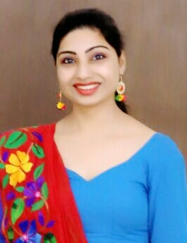
Faculty Profile
Faculty name - Dr. Shalu Kaur
Highest Qualification – M.Phil, P.hD ,UGC- NET
Designation - Assistant Professor
Specialization - Sufism, Dramatics, Feminism
Experience - 7 years+

Slide 7
Retired Faculty
Name - Mrs. Amarjit Bali
Qualifications - M.A (Punjabi)
Date of Joining - 1975
Date of Retirement - November, 2016

Slide 8
S. No. | Research Papers Detail. | ISSN/ISBN No. | Journal Name | Year
1. | Balwant Gargi Di Pustak Nim De Pattay : Ek Adhiyan Single author | 2456-253X | Aabru | 2017
2. 3. 4. | Jarnail Singh Rachit Kahani Sangreh “Kaaley Verkay” De Sarokar Single author Baal Sahit : Samasiyavan Ate Sambhawnavan Rashtri Ekta wich Bhasha di Bhumika | 978-93-85670-24-4 2456- 253X 2453- 253X | Pragaas Aabru Aabru | 2017 2023 2024

Slide 9
S.no. | Publication Type | Title of the Book | ISSN/ISBN No. | Year
1. | Translation work | Natak Trikree | 978-93-89778-48-9 | 2020
2. | Chapter in Edited Books Waryam Mast De Natakan Vich Naari-Chetna Pehle Sikh Raaj Da Ussraiya: Baba Banda Bahadur Punjabi Natakan Vich Naarivadi Maslay. Gurmat Sahitya me Matrabhumi ki Avdharna | Nawan Punjabi Natak :Ik Adhiyain Baba Banda Singh Bahadur : Mahan Sikh Jarnail Punjabi Natak: Sandrab Ate Samikhia Concept of Motherland in Hindu & Russian Literature | 81-87654-30-9 81-87654-24-4 978-93-5112-247-0 Accepted | 2017 2017 2017 2025

Slide 10
3. Books Authored 4. Editor of Book | Punjabi Sufi Kavita Da Lokdharaai Peripekh Waryam Mast De Natakan Da Narivadi Adhyan Punjabi Sahit: Vibhin Peripekh Kaav Chintan te Vihar | 81-8138-059-2 81-8138-057-6 81-8138-071-1 81-8138-068-1 | 2016 2017 2019 2018

Slide 11
ANNUAL REPORT
JULY 2023- JUNE 2024

Slide 12
On the occasion of Guru Nanak Dev Ji’s Birthday, Department organized a Lecture on ‘Guru Nanak Bani Vich Naarivadi Chetna’ by Prof. Beant Kaur (S.G.N.D Khalsa College, University of Delhi). Event was followed by the Guru ka Langar.

Slide 13
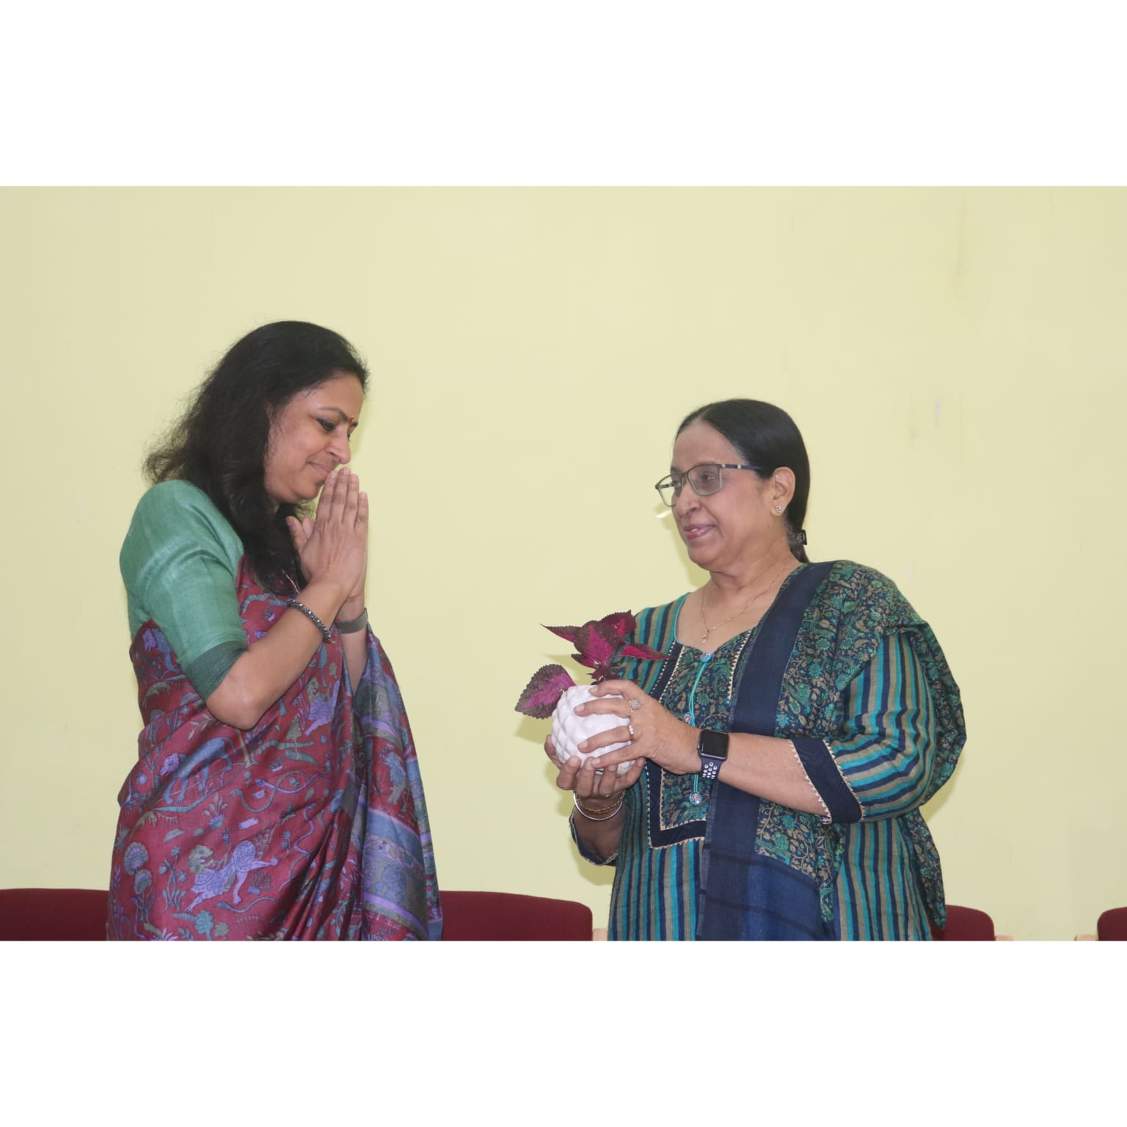
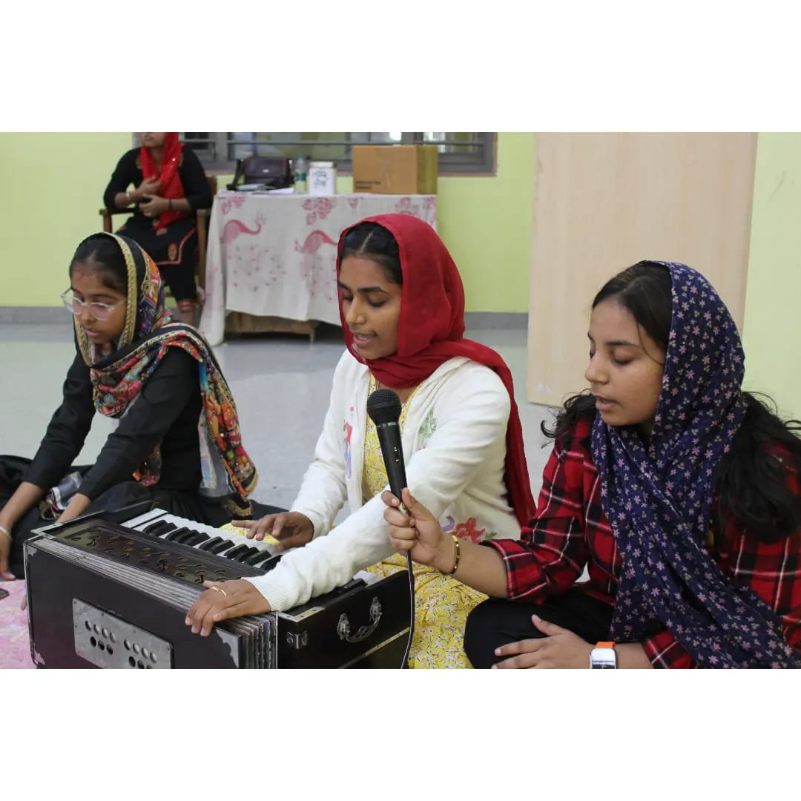

Slide 16
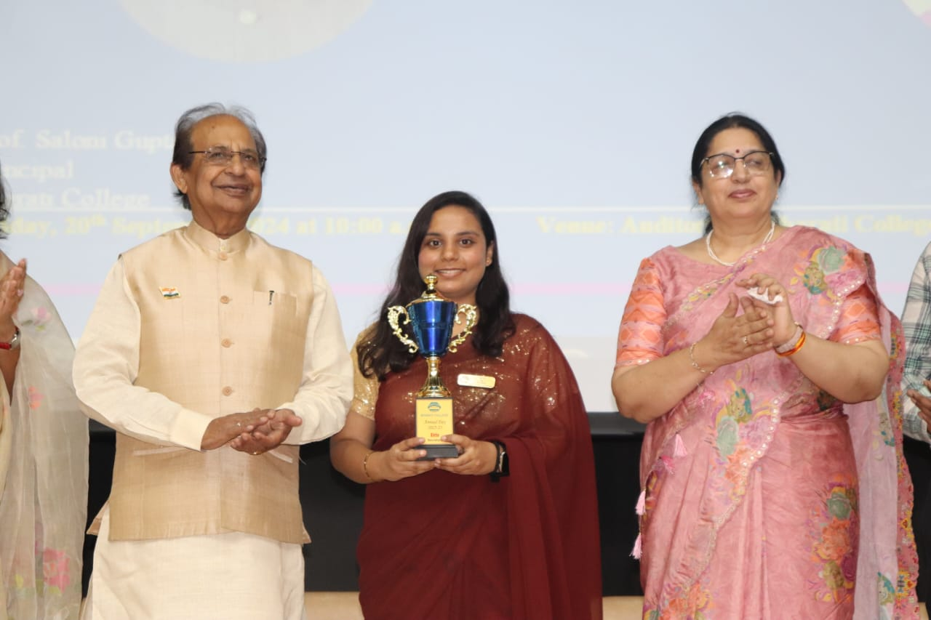
A Glorious Achievement for the Punjabi Department : Ms. Komal Bakshi has been elected as the Student Union President (2022-2023) of Bharati college.
Ms. Ekta became Student Union Secretary in (2023-2024) of Bharati college. Bringing Pride and Honor to our Department.

Slide 17
STUDENTS ACHIVEMENTS
Harpreet Kaur won 3rd position in Inter college Folk Dance competition held at Bharati College on dated : 25 August 2023
Amisha won 2nd position in Inter College Folk Solo-Singing competition held at Aditi Mahavidyalaya University of Delhi on dated : 13 October 2023
Our students Archana and Puru won 1st prize in Inter College Singing competition held at HIMT Group of Institute, Greater Noida on 28th February 2024
Nisha and Sweta Shakya won 2nd position in Inter College Folk Dance competition held at Maitry College, University of Delhi, on 12th March 2024
Our student Parvi Khurana won 2nd position in Inter College Folk Singing competition held at S.G.N.D Khalsa college, University of Delhi, on 12th March 2024

Slide 18
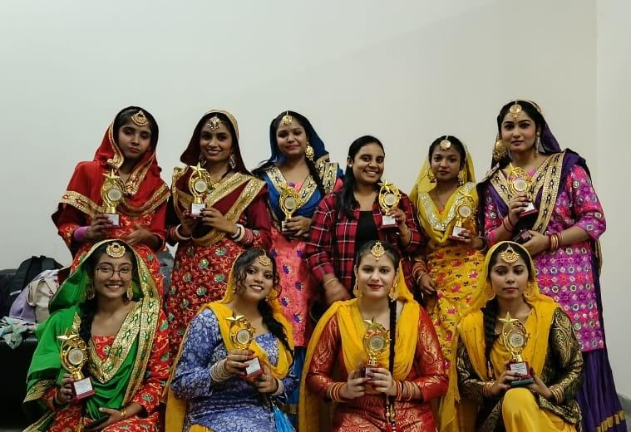
Simran Kaur won 3rd prize in Inter college Folk Dance competition held at Bharati college, University of Delhi, on 21st March 2024
One of our student Akansha won 2nd prize in Inter college Photography competition held at Bharati college, University of Delhi, on 15th April 2024
Total :-1st Prize - 01
2nd Prize - 04
3rd Prize - 02

Slide 19
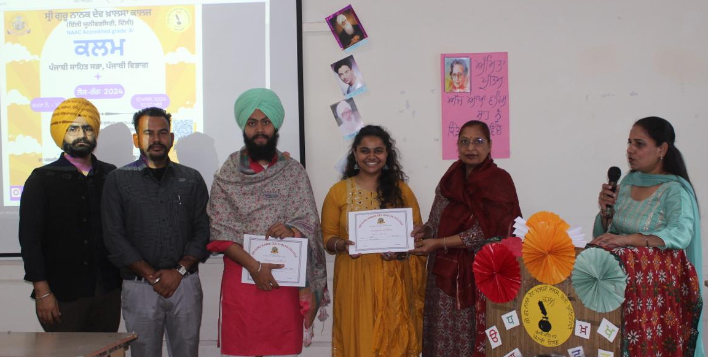
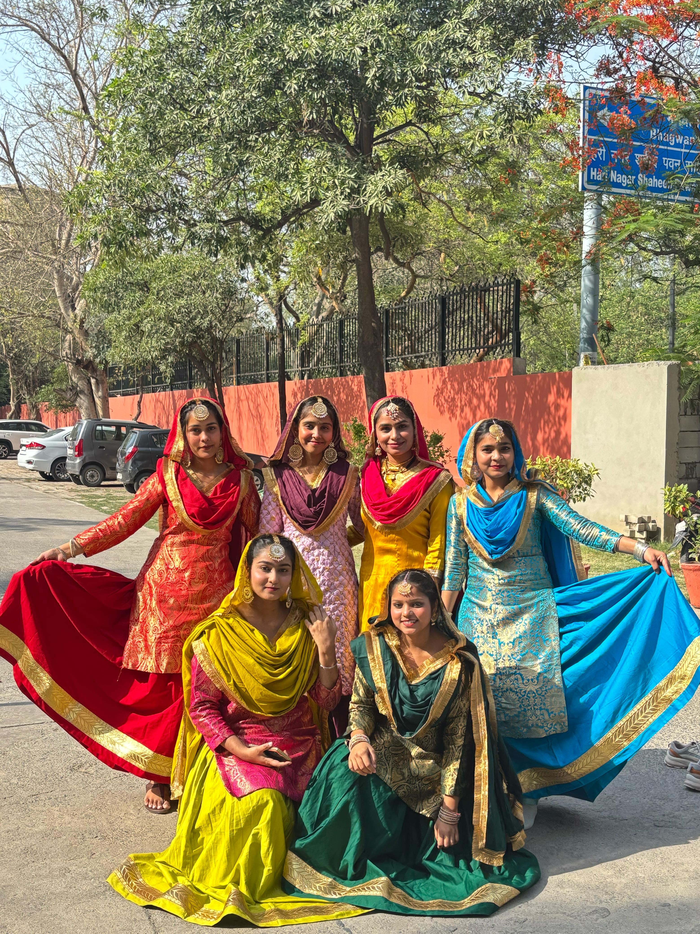

Slide 20
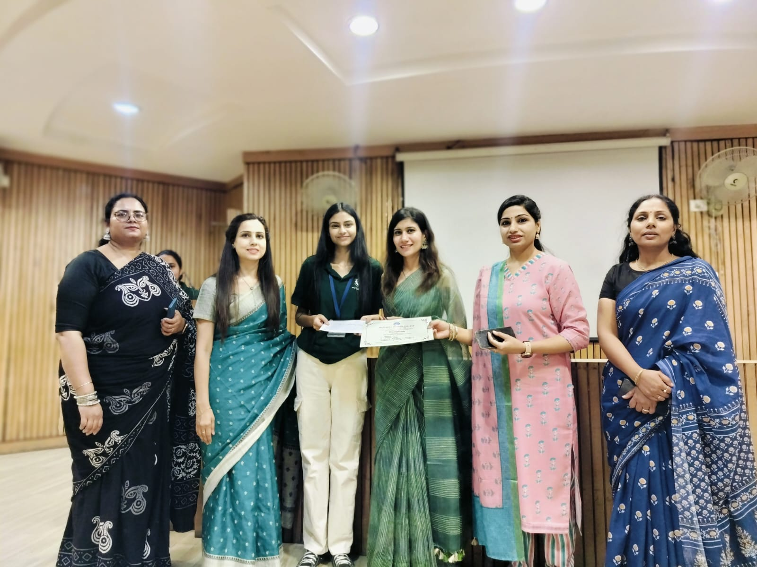
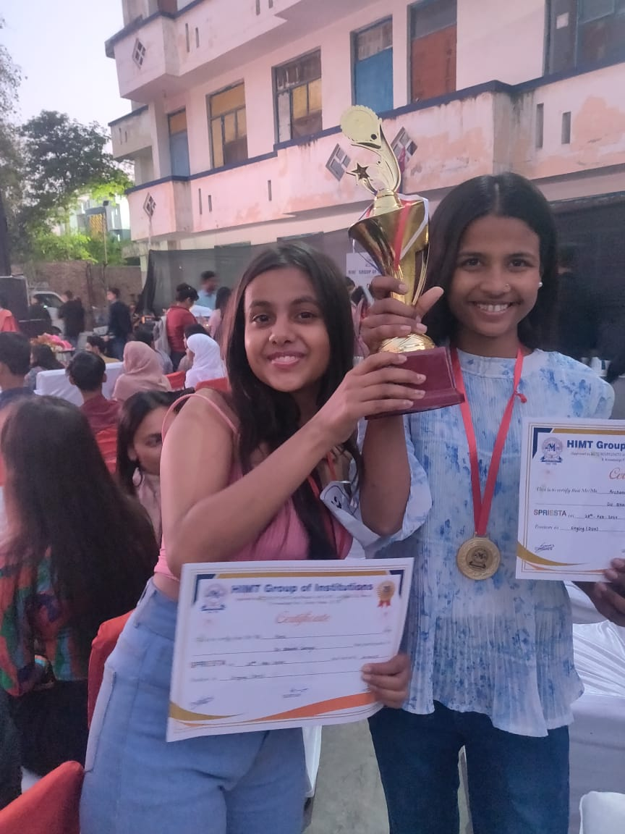

Slide 21
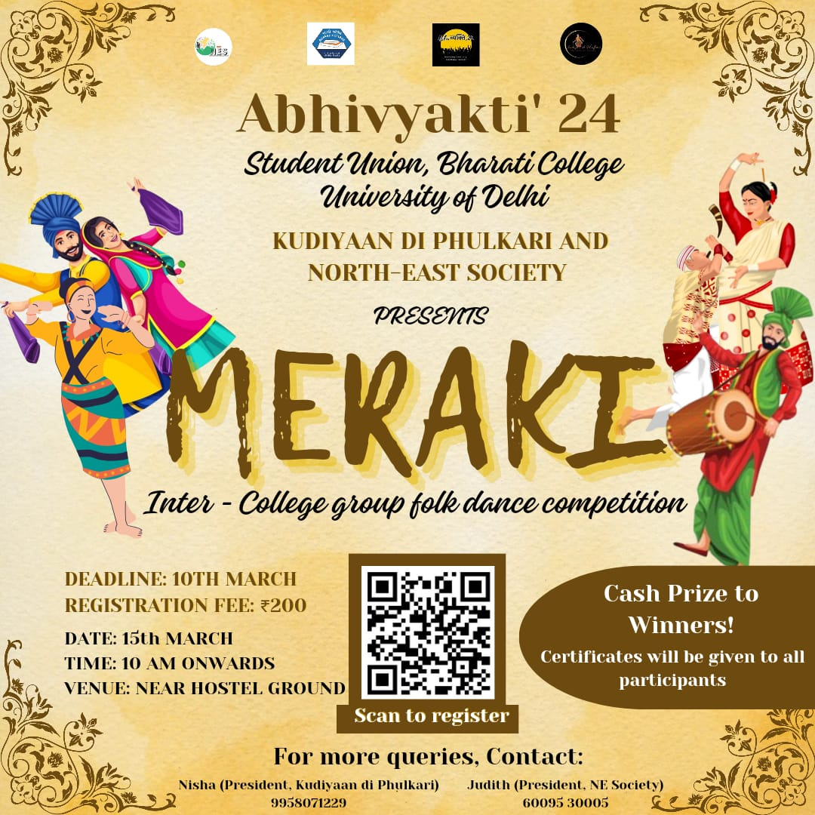
Department of Punjabi and Kudiyaan Di Phulkari Society in collaboration with North-East Society was organized Group Folk Dance Inter college Competition in ABHIVYAKTI’ 2024.

Slide 22
ANNUAL REPORT
JULY 2024 - APRIL 2025

Slide 23
STUDENTS ACHIVEMENTS
Harpreet Kaur won 3rd prize in Bani Kirtan –Declamation & Akharkari Inter college competition held at Mata Sundri College for Women, University of Delhi on dated : 22 October 2024
Harpreet Kaur won 1st prize in Traditional Dress Inter college competition held at Bharati college on dated : 30 January 2025
Amrita Yadav won 2nd position in Inter college Rangoli competition held at Satyawati college, University of Delhi on dated : 20 Febuary 2025
Harpreet Kaur & Ritika won 1st prize in Inter college Quiz competition held at Dyal Singh college, University of Delhi on dated : 21 Febuary 2025

Slide 24
Simarpreet Kaur & Harpreet Kaur won 1st prize in Inter college Debate competition and Best Pair Award held at Bharati college on dated : 05 March 2025
Amrita Yadav win 2nd position in Inter college Painting competition organized by ABVP & ART MEISTERS on dated : 07 March 2025
Amrita Yadav won 3rd position in Inter college Rangoli competition held at P.G.D.A.V college, University of Delhi on dated : 08 March 2025
S. Muthu Priya won 3rd prize in Inter college Talent Hunt competition held at Bharati college on dated : 20 March 2025
In same competition Amrita Yadav won 2nd prize in Inter college Folk singing held at Bharati college on dated : 20 March 2025

Slide 25
Again, Amrita Yadav won 3rd prize in Inter college Rangoli competition held at Delhi Institute of Advance Studies on dated : 22 March 2025
Simran Kaur won 3rd position in Inter college Folk Dance competition held at Maitreyi college, University of Delhi on dated : 26 March 2025
Amrita Yadav win 3rd position in Inter college Rangoli competition held at Shri Arvind Mahavidyalaya, University of Delhi on dated : 01 April 2025
Simran Kaur won 3rd prize in Inter college Folk Dance competition held at S.G.T.B Khalsa college, University of Delhi on dated : 05 April 2025
Harpreet Kaur won 1st prize in Inter college Cultural Ramp Walk competition organized by Youth United for Vision and Action, Bharati college on dated : 21^{April} 2025

Slide 26
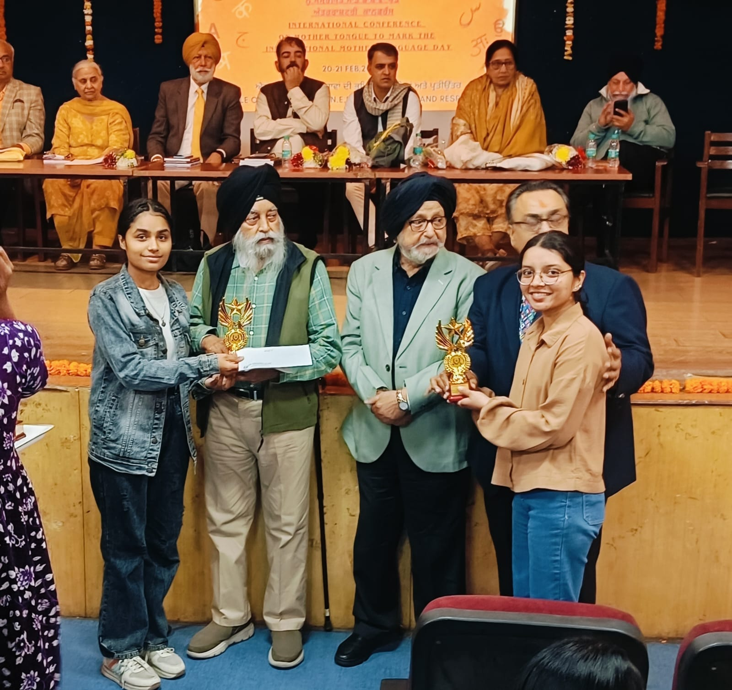
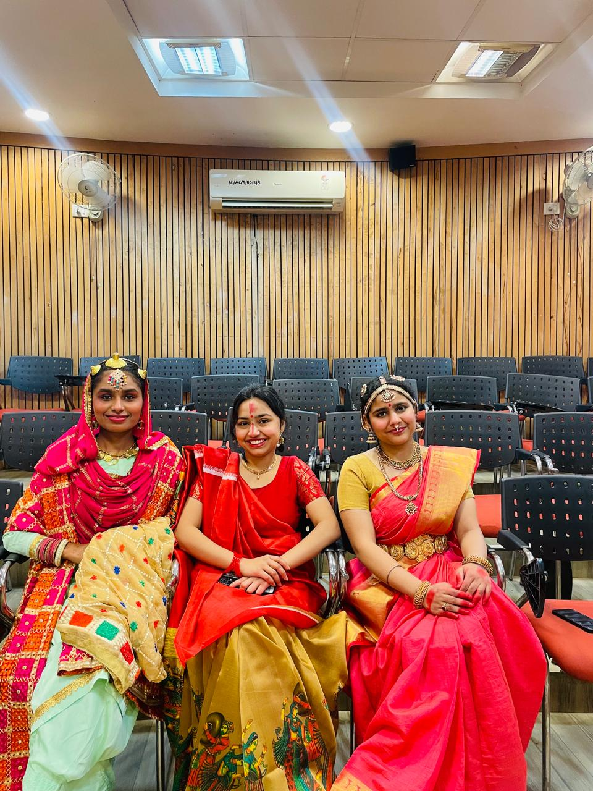
In same event Simran Kaur win 3rd prize in Inter college Folk Dance competition on dated : 21 April 2025
Total :- 1st Prize - 04
2nd Prize – 03
3rd Prize - 08

Slide 27
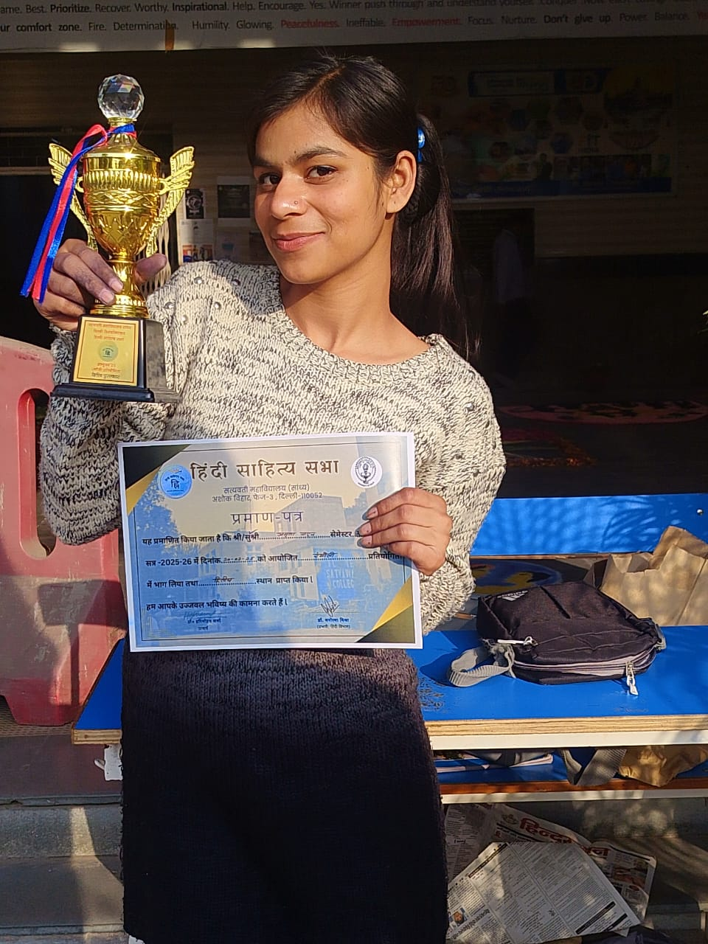

Slide 28
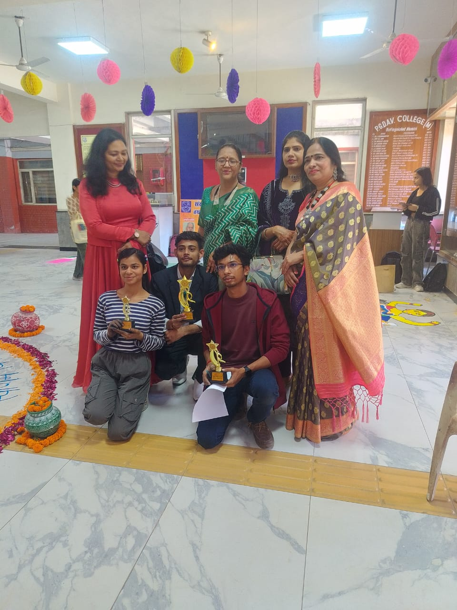
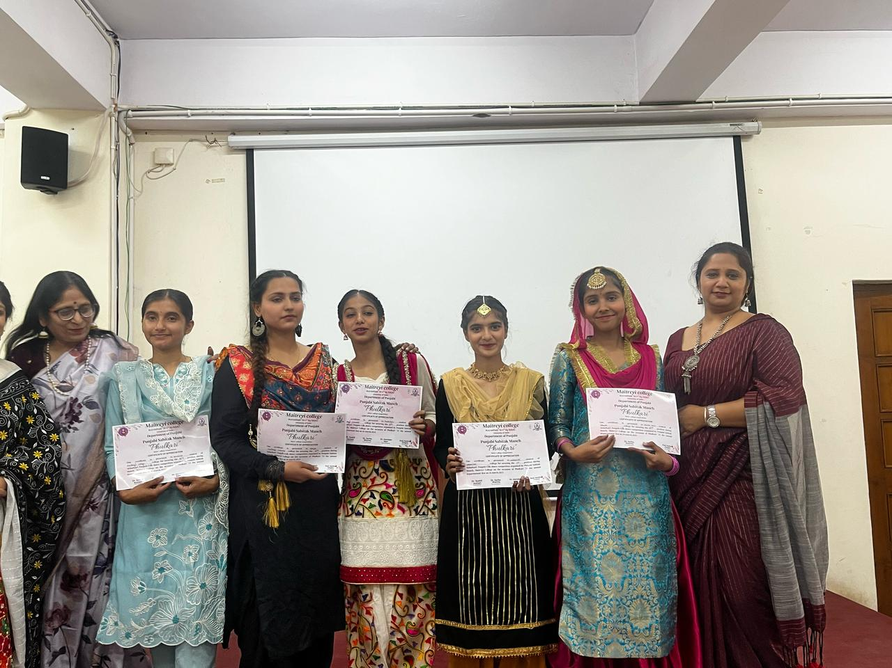

Slide 29
Department of Punjabi celebrates a Guru Nanak Dev Ji’s Birthday with Shabad Kirtan by the Students. The purpose of teaching Gurbani Kirtan to students is to connect them with their spiritual and cultural roots, instill moral values and inspire devotion and discipline through the sacred music and teaching of the Sikh Faith.

Slide 30
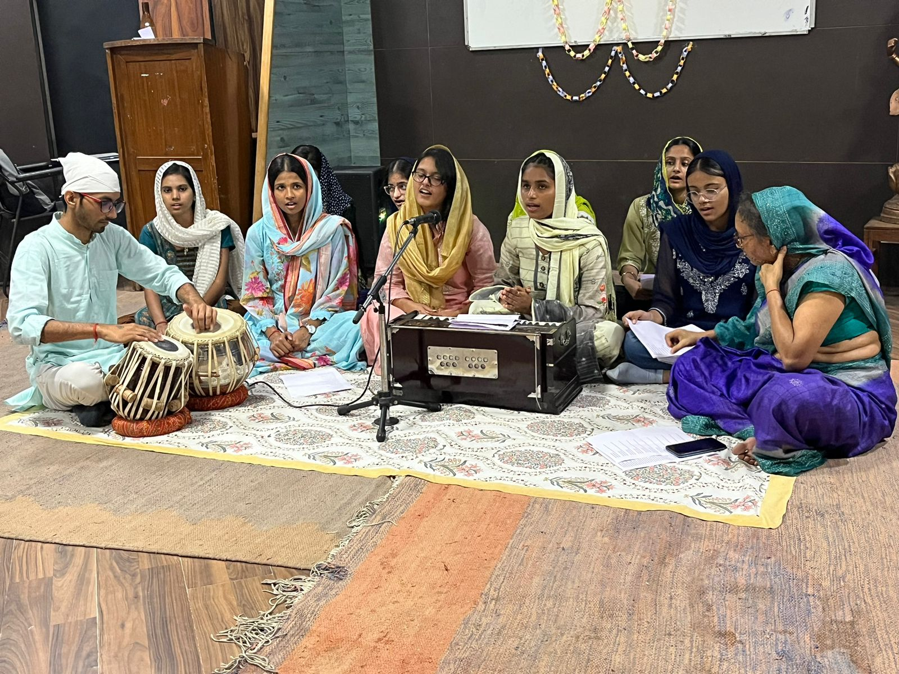

Slide 31
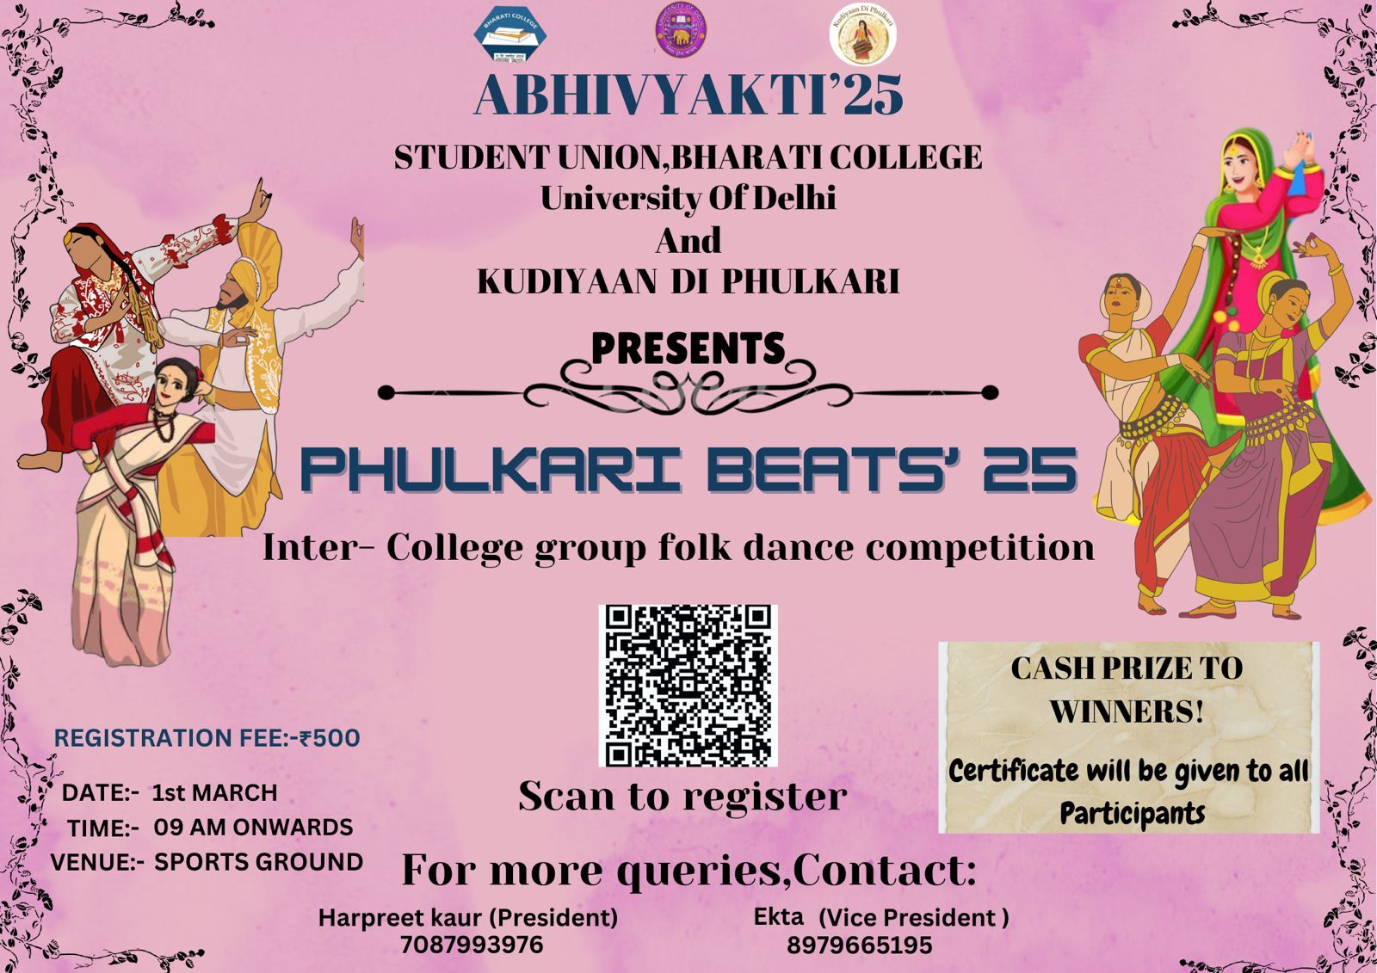
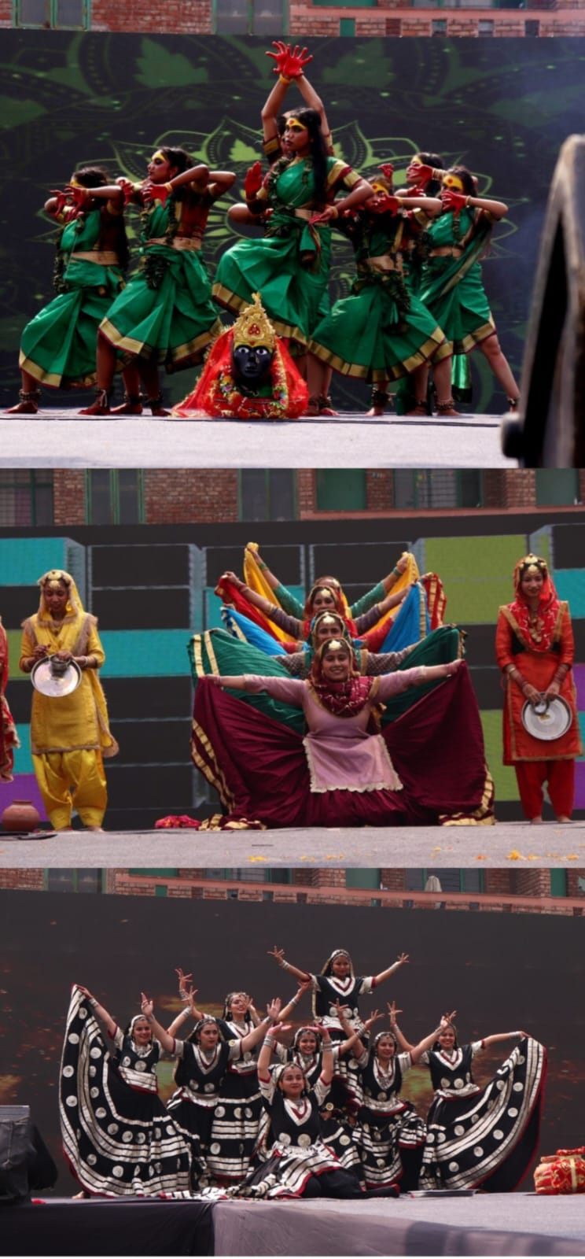
Department of Punjabi was organized Group Folk Dance Inter college Competition in collaboration with Kudiyaan di Phulkari Society in ABHIVYAKTI’ 2025.

Slide 32
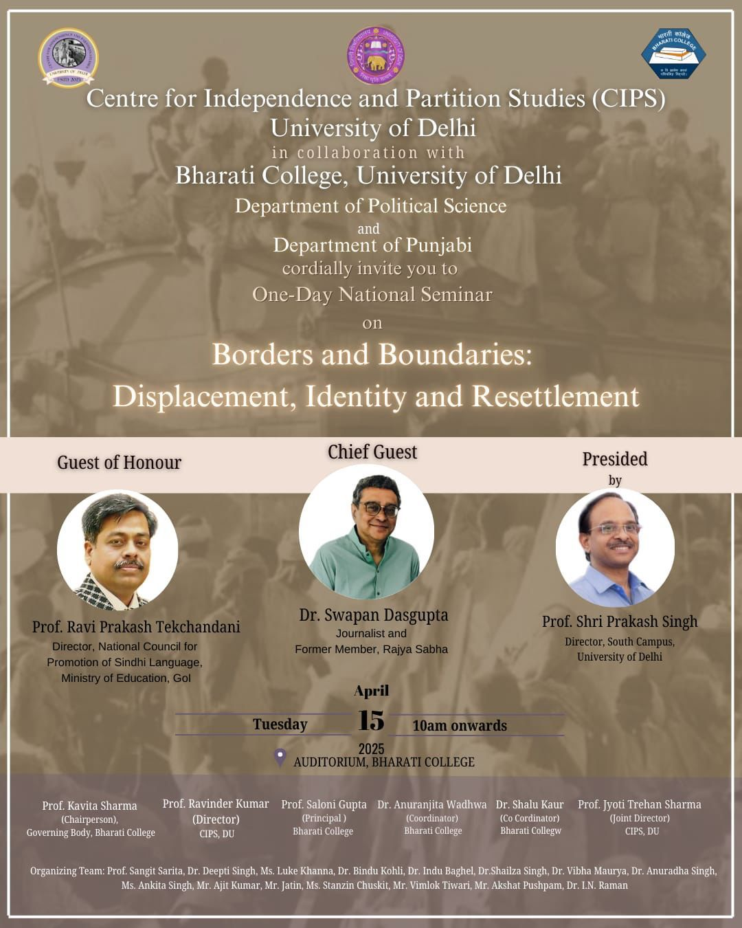
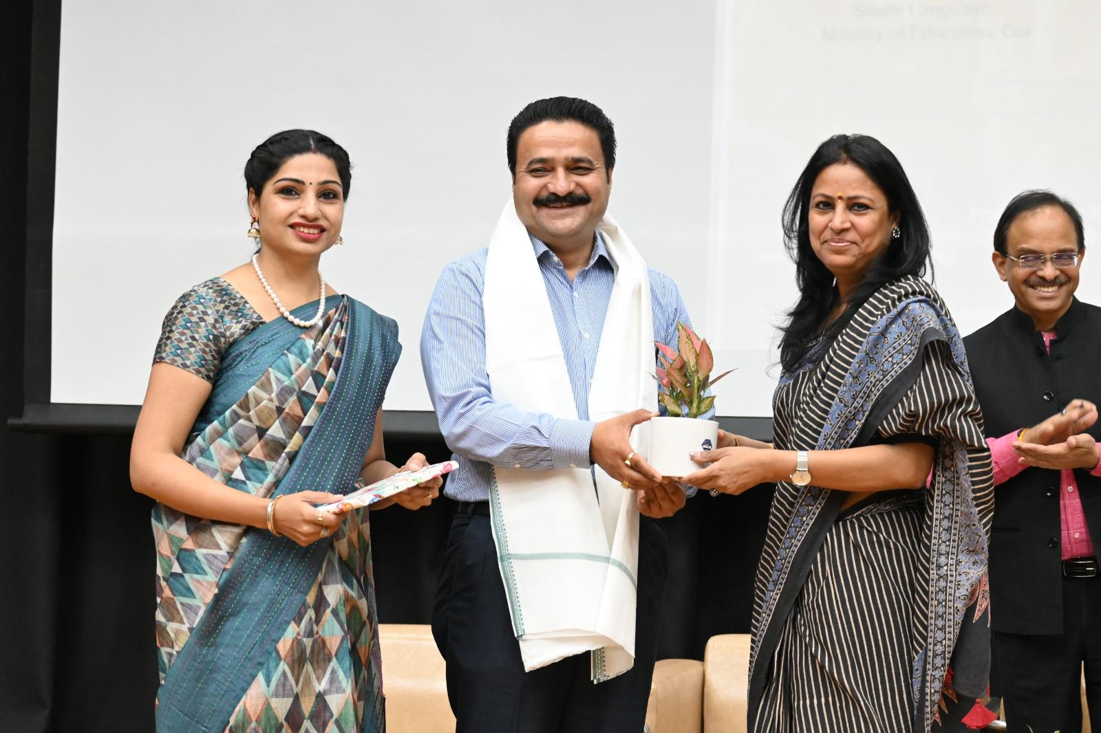
Centre for Independence and Partition Studies, University of Delhi in collaboration with Department of Political Science and Department of Punjabi organized a One-Day National Seminar on Borders and Boundaries: Displacement, Identity and Resettlement.

Slide 33
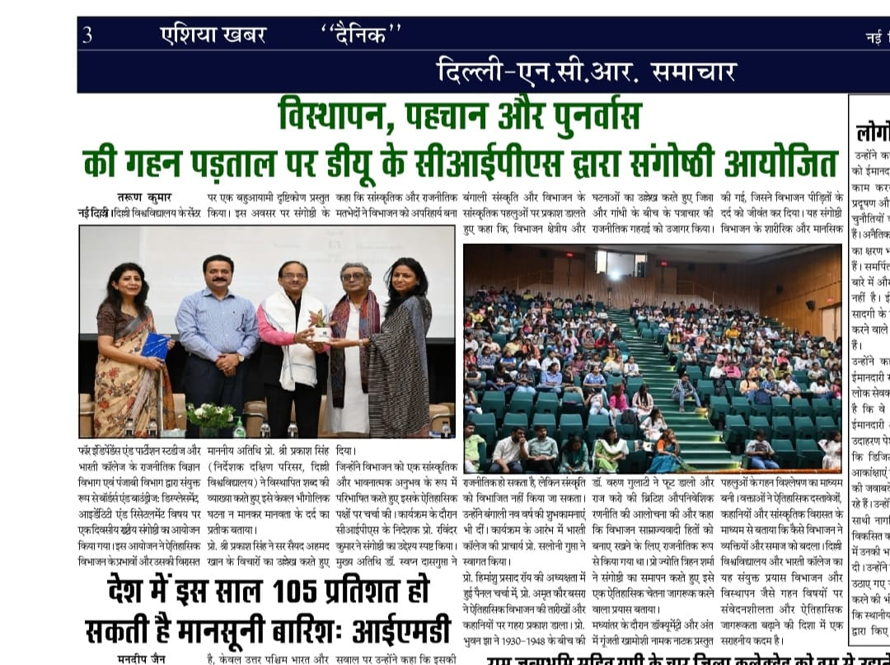
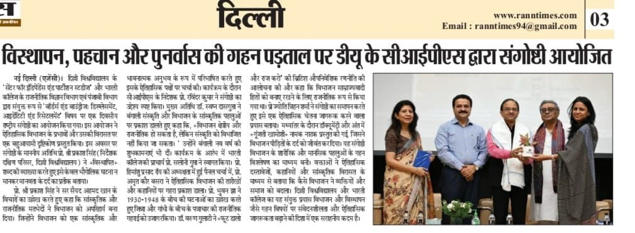
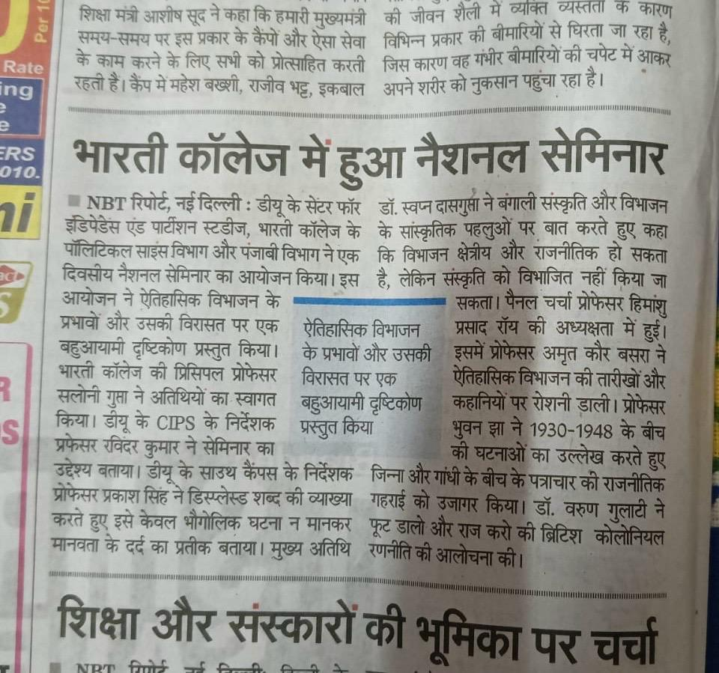
NEWS PAPER

Slide 35
Student Progression to Higher Education
Savita is pursuing M.A in Punjabi from University of Delhi.
Gurjot Kaur is pursuing M.A in Social Work from IGNOU.
Komal Bakshi is pursuing M.A in Hindi from IGNOU.
Ashmeet Kaur is pursuing Course of Chef from Tedco Goodrich chefs academy.
Mansi is doing Degree in Data Science-WD from JODO.
Rupali is pursuing M.A in English from IGNOU.

Slide 36
Details of Alumni of the Department with their present employment:
Amanpreet Kaur working as Operations Manager at RSB, Pvt, Ltd.
Divya Verma working as Ground Staff at Oman Airlines.
Tanya Sharma working as Office Staff at Lenergizer Pvt, Ltd.
Mandeep Kaur working as School Teacher in Govt. School, Punjab.
Vanshita Sachdeva working as School Teacher, Delhi.
Harman Kaur working as Office Staff at Redefine Marcon.
Simarjot Kaur working as Senior Executive at JM Enterprises.

Slide 37
Result Analysis
With the hard work of students and encouragement of faculty , we are able to achieve 100% Results.
Our students have excelled in different competitions organized by different colleges and brought laurels for our beloved institutions.
Students are now able to connect their selves with their heritage through Folk Dances and Cultural activities etc.

Slide 38
Innovative Teaching Pedagogy /Best Practices of the Department
Assign students tasks where they create documentaries, short films, podcasts, or blogs on topics related to Punjabi culture, literature, or history. This could include interviews with community members or folk artists.
Organize field trips to Punjab for students to experience the culture firsthand—visiting historical sites, local theaters, and folk festivals. This offers students a deeper connection to the subject.
Invite local Punjabi artists, poets, musicians, and community leaders for workshops, performances, or lecture series.
Integrate Punjabi music, dance, and drama into language learning. Students could be encouraged to act in plays, perform in Gidda or Bhangra groups, or compose Punjabi poetry or songs.

Slide 39
Weakness of the Department
Limited Student Enrollment: Fewer students may opt for Punjabi as a major due to career concerns, leading to under-enrollment. students and parents may consider Punjabi studies as less “useful”.
Lack of Career-Oriented Programs: The curriculum may not be aligned with modern job markets (e.g., media, translation, publishing, content writing, etc.).
Insufficient Funding: Often, Punjabi departments receive less financial support compared to other departments.
Neglect of Spoken & Functional Language Skills: Courses may overly focus on classical or literary Punjabi, ignoring conversational or practical usage for students.

Slide 40
Future Plans
Introduce elective courses like Punjabi Cinema, Translation Studies, Punjabi Journalism, and Folklore.
Launch certificate/diploma programs in Punjabi Translation, Content Writing, Media & Broadcasting, and Scriptwriting. Partner with local media houses, publishers, and cultural organizations for internships.
Develop e-content, podcasts, YouTube series, and online archives of Punjabi literature and oral history. Launch a department blog or magazine showcasing student work and cultural commentary.
Organize literary festivals, kavi darbars, folk music/dance events, and theatre workshops. Collaborate with artists, poets, and scholars from Punjab and the diaspora.

Slide 41
Conduct outreach programs in local schools and communities to promote Punjabi language and heritage.
Establish a strong alumni network to mentor students and support departmental initiatives.
Create international linkages with Punjabi departments abroad for exchange programs and collaborative research.
Enrich the departmental library with multimedia resources and critical texts.

Slide 42
Thank you
With Regards
Dr. Shalu Kaur
Department of Punjabi

